Slide 1
Welcome to the jungle the future of etfs
Eric Balchunas
Senior ETF Analyst, Bloomberg Intelligence
March 2018

Slide 2
My critical themes
The Internet Theory
WMDs, Bubbles and Marxism
The Great Cost Migration
The Fall (and Rise) of Active
The Spaghetti Cannon
The Smart Beta Spectrum
Nasty Surprises

Slide 3
The Internet Theory

Slide 4
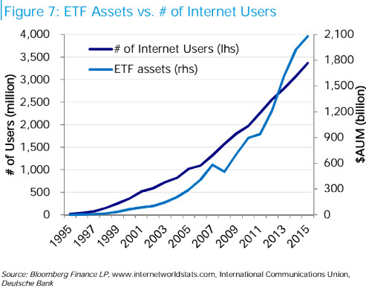
The internet theory: AUM vs internet users

Slide 5
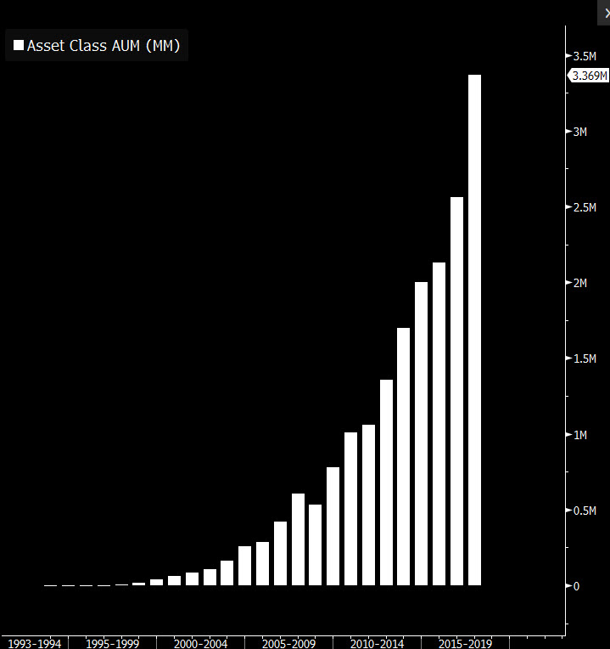
The hockey stick

Slide 6
Etfs compete against everything
ETFs
MFs
SMAs
Single Securities
Futures

Slide 7
Catalysts for future growth
Regulations
Robos
Millennials
Institutions
Governments
Innovation
Smart-Beta
Fee War

Slide 8
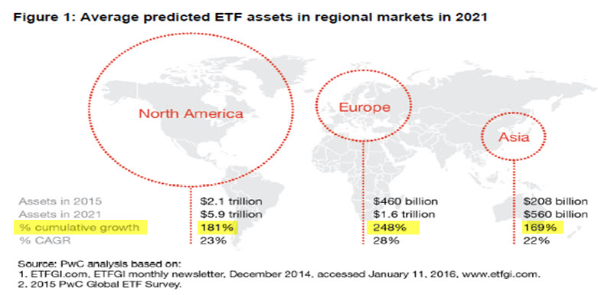
Etf assets expected to double
Projected growth rates of ETFs across globe…

Slide 9
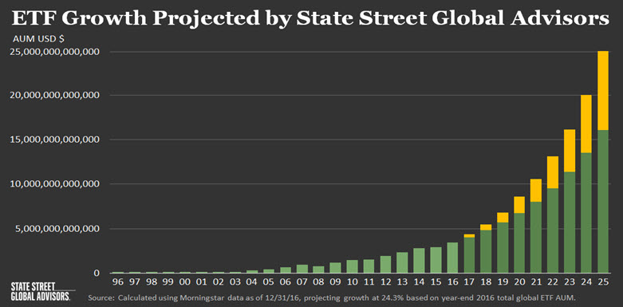
$25 Trillion by 2025!?

Slide 10
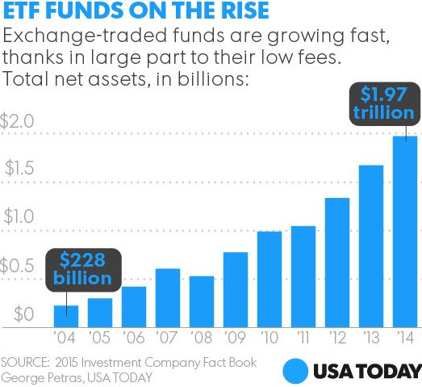
THE media tipping point
2000: Bloggers, Academic Papers, Conferences
2005: Index Universe, ETFdb, Morningstar
2010: Barron’s, Bloomberg, FT, WSJ
2015: Time Magazine, USA TODAY

Slide 11
WMDs, Bubbles and Marxism

Slide 12
Top 10 etf ATTACKS of 2017:
Weapons of mass destruction
Fault line for the next earthquake
Causing stock market bubble
Worse then Marxism
Worse than the misuse of antibiotics
Distorting fundamentals
Making market dumb
Destructive to growth creation
Hurting the economy
They’re hideous

Slide 13
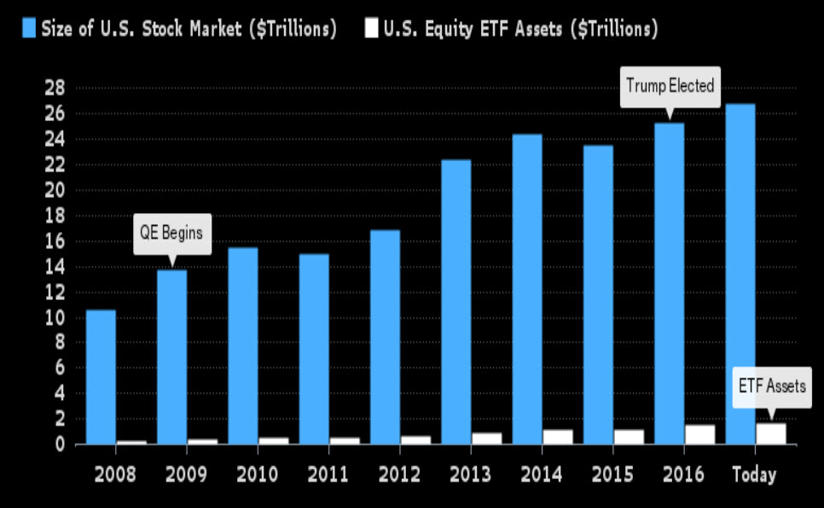
ARE ETFS CAUSING A BUBBLE?
They only own about 6% of stock market…

Slide 14
Still, ETFS OWN LESS THANK YOU THINK
Not exactly the tail wagging the dog…
ETF’S PERCENTAGE OWNERSHIP OF THE ASSET CLASS THEY TRACK
ASSET CLASS | TOTAL MARKET CAP | ETF ASSETS | % ETF OWNERSHIP
U.S. EQUITIES | $ 28 TRILLION | $ 1.9 TRILLION | 6-7%
U.S. BONDS | $ 39 TRILLION | $ 520 BILLION | 1-2%
GOLD | $ 7.5 TRILLION | $ 35 BILLION | 0.5%
Source: Bloomberg, World Gold Council, SIFMA

Slide 15
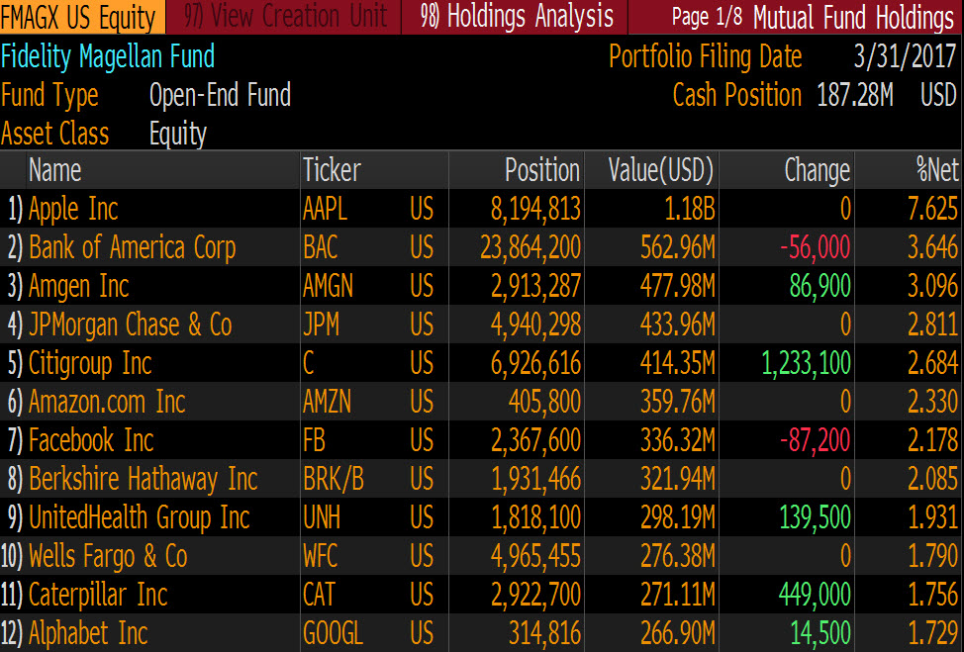
From closet indexing to actual indexing
Owning the same stocks, just in a different format…

Slide 16
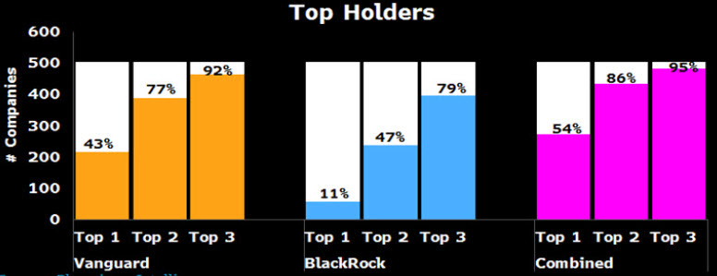
Will passive lead to marxism?

Slide 17
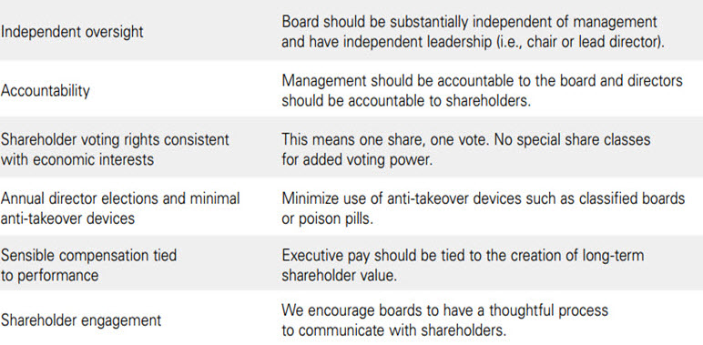
Vanguard’s corp governance

Slide 18
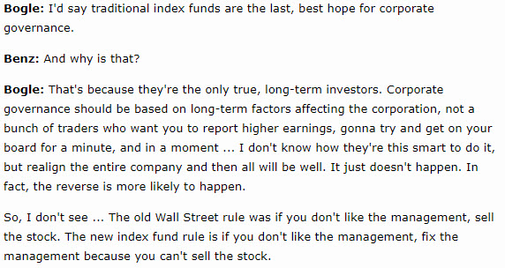
Are passive funds better owners?

Slide 19
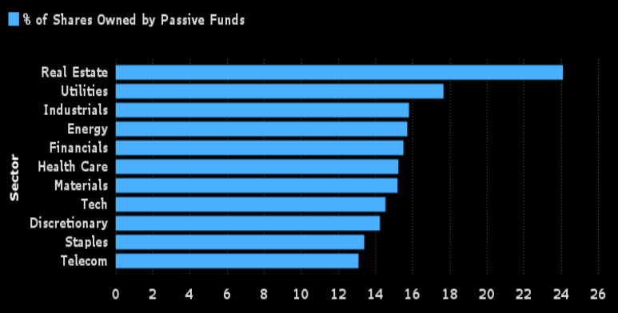
PASSIVE OWNERSHIP BY SECTOR

Slide 20
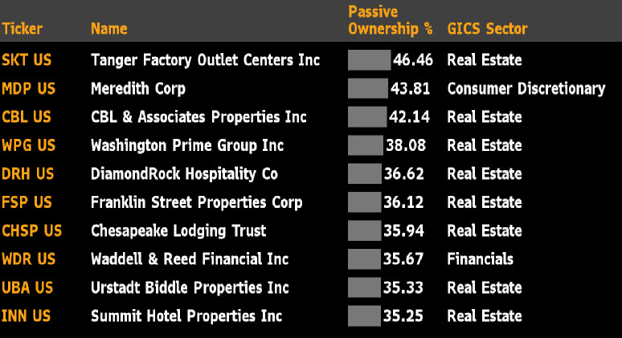
Stocks with most passive ownership

Slide 21
Stocks with LEAST passive ownership

Slide 22
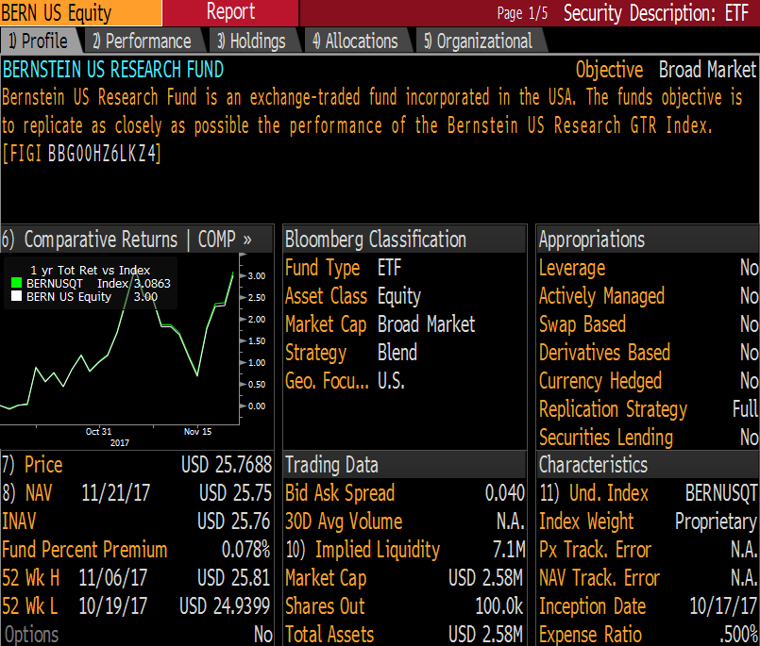
Bernstein joins communist party

Slide 23
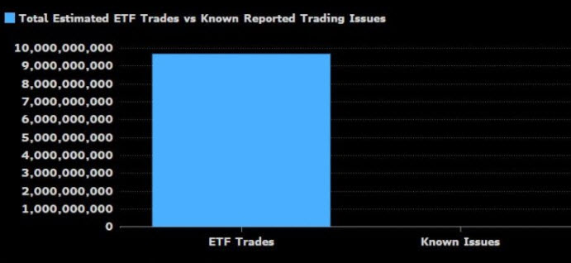
Etfs: 10 billion served

Slide 24
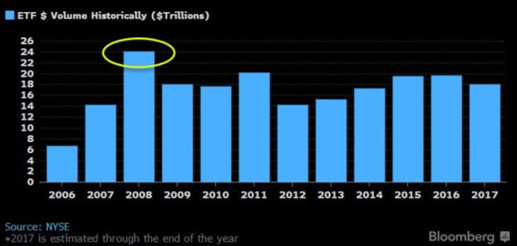
WHEN GOING GETS TOUGH, ETFS GET GOING

Slide 25
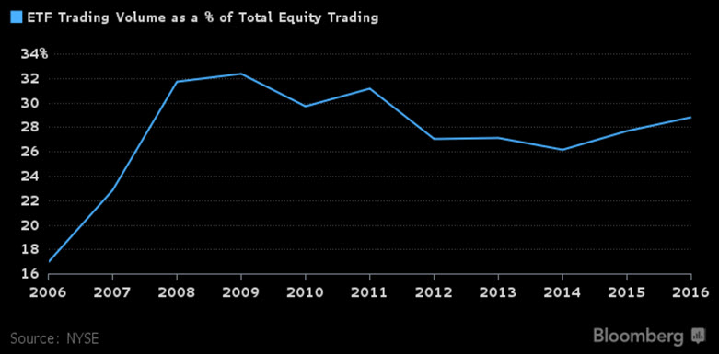
Legit worry: Vampiring

Slide 26
Legit worry: over-trading
“The average turnover for an ETF is 400 percent a year. And
SPDR is 3,000 percent. And here you are talking to a guy who thinks 3 percent turnover is pushing the envelope.”
--John Bogle, Vanguard
“I think the temptation to trade—whether there are ETFs in the world or not—is going to be there. There are people that are always going to want to twiddle the knobs. It doesn’t really matter if you provide the product, they will find it. They will find currencies. They’ll find futures. They’ll find a sports book.”
--Josh Brown, Ritholtz Wealth Management

Slide 27
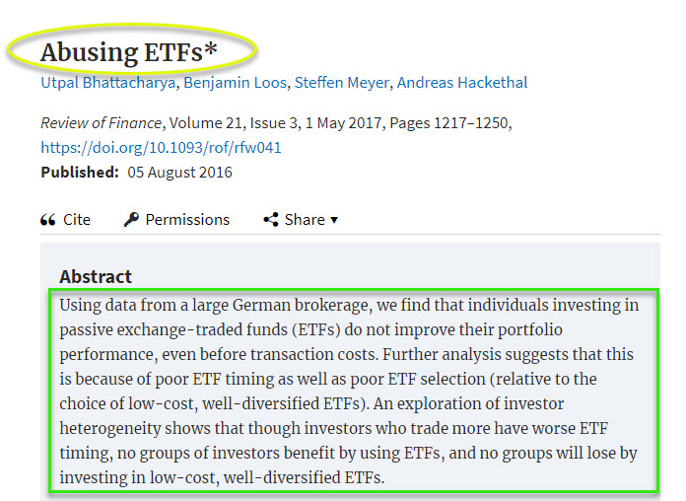
Legit worry: Etf abuse

Slide 28
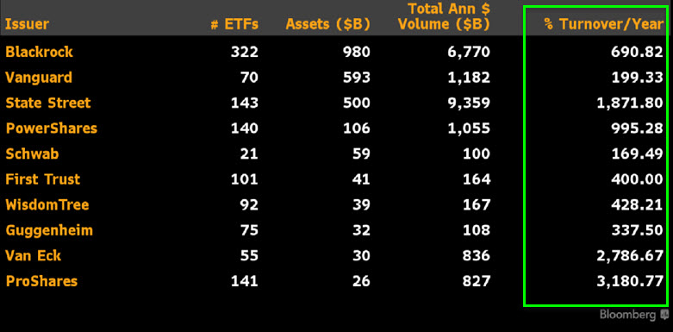
Some etfs are traded, others are not

Slide 29
The Great Cost Migration
(aka “The Vanguard Effect”)

Slide 30
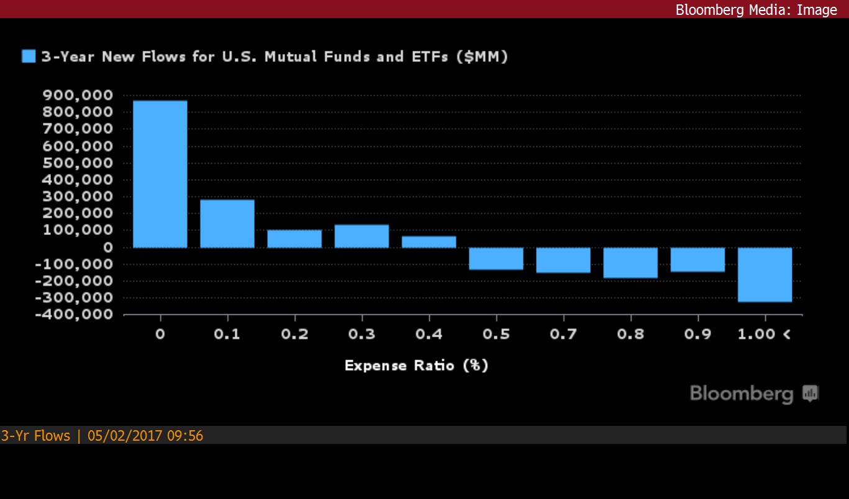
The Great Cost migration

Slide 31
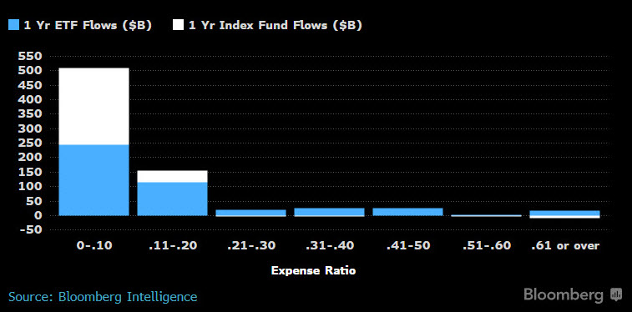
Cheap Beta is a Smash hit

Slide 32
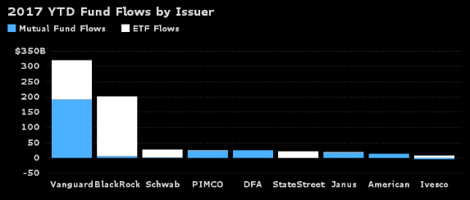
Vanguard, Blackrock & everyone else…

Slide 33
Vanguard flows are “bogle-proof”

Slide 34
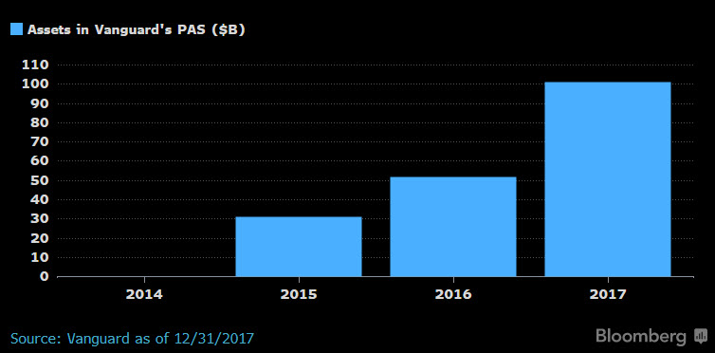
Assets in vanguard’s personal advisor service…

Slide 35
The Fall (and Rise) of Active Management

Slide 36
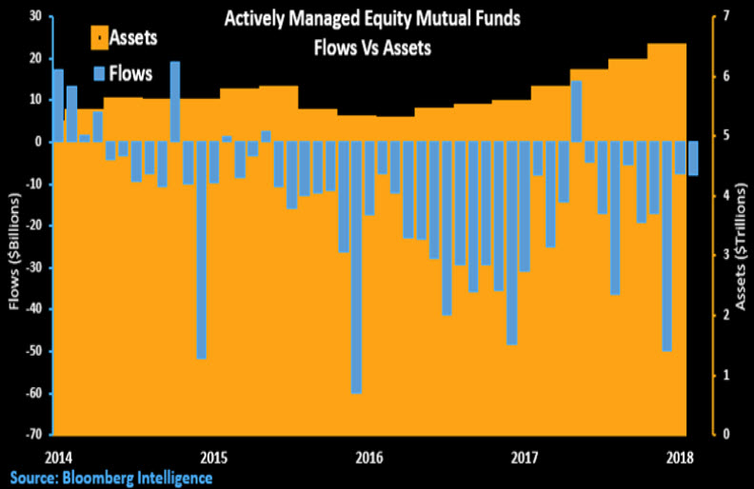
#1: do nothing

Slide 37
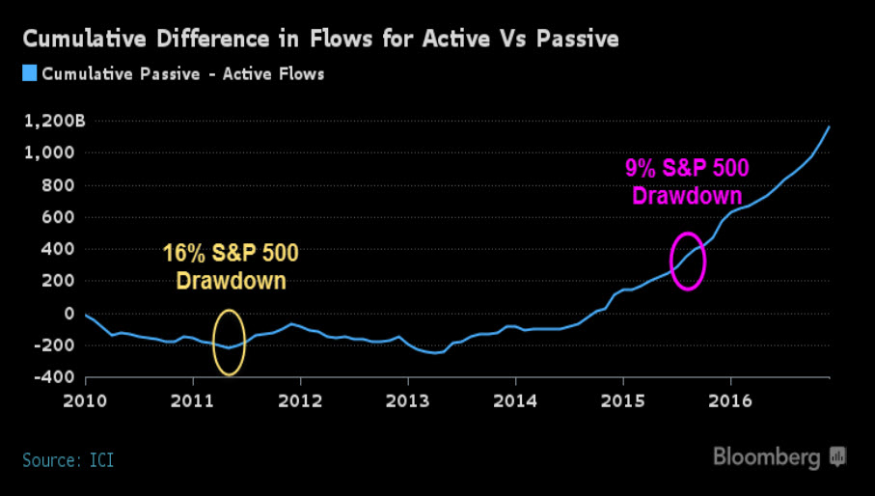
..And don’t root for a selloff!

Slide 38
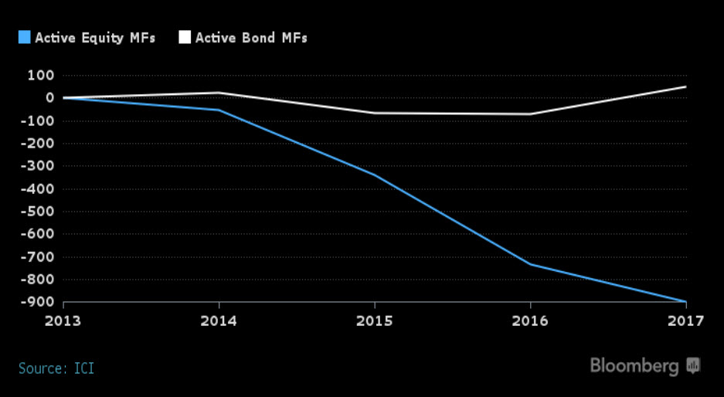
#2: Be a bond manager

Slide 39
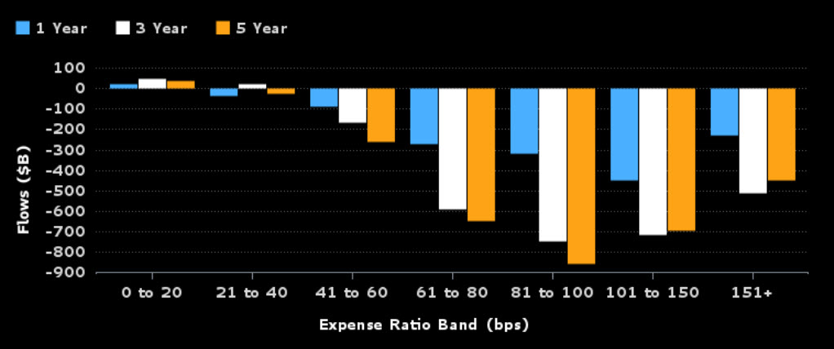
#3: Lower fees

Slide 40
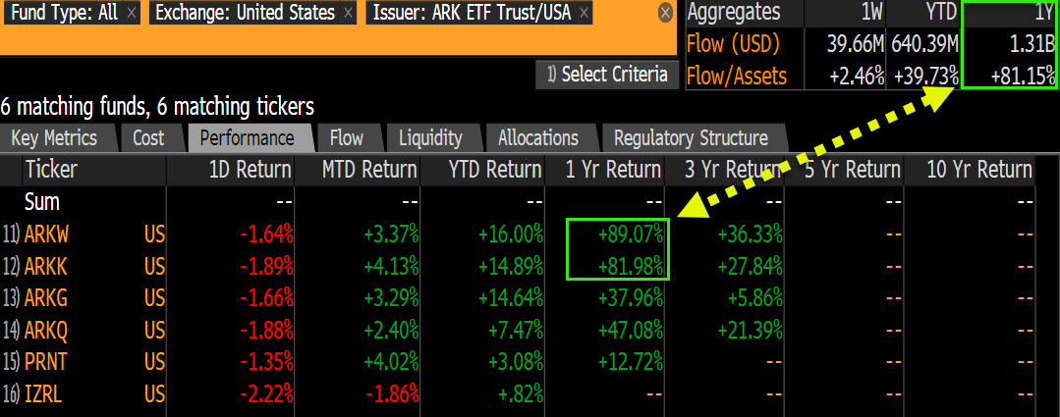
#4: Adopt a ‘babe ruth’ mentality

Slide 41
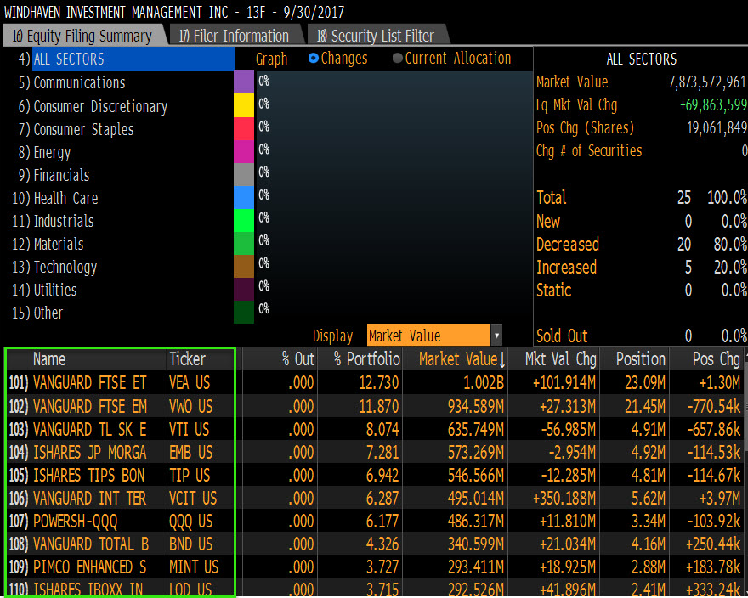
#5: Alpha through beta

Slide 42
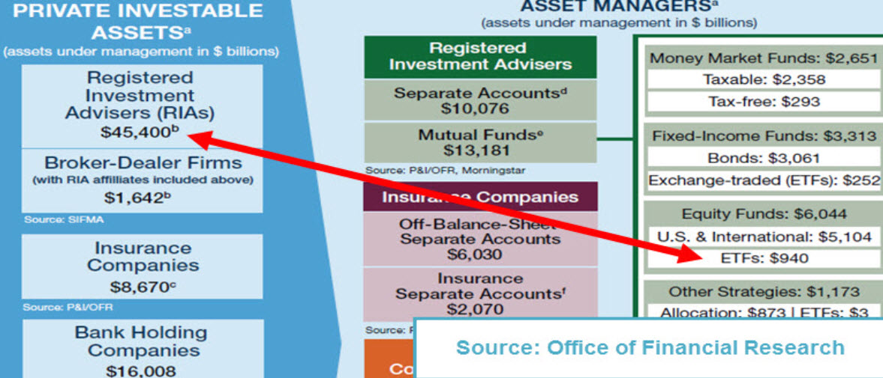
#6: Advisor take role of active mgr

Slide 43
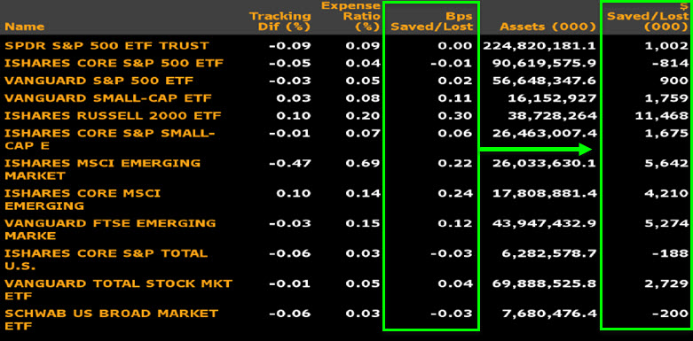
#7: passive port management
gles

Slide 44
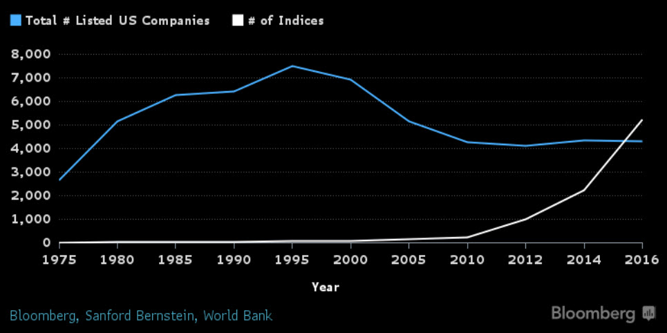
#8: make a smart-beta index

Slide 45
The Spaghetti Cannon

Slide 46
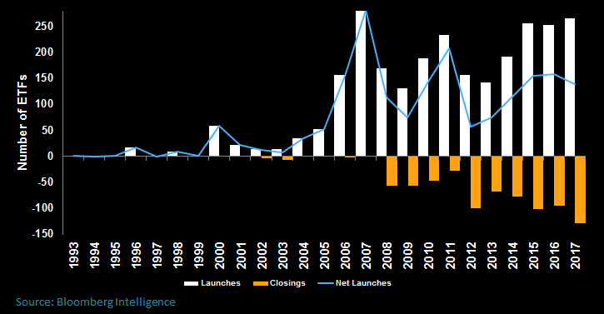
Launches and closures

Slide 47
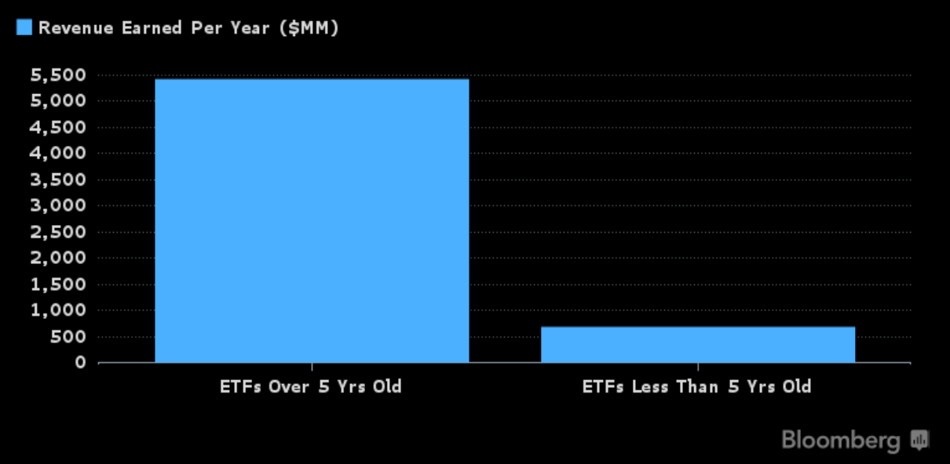
Takes time to ‘grow’ an etf

Slide 48
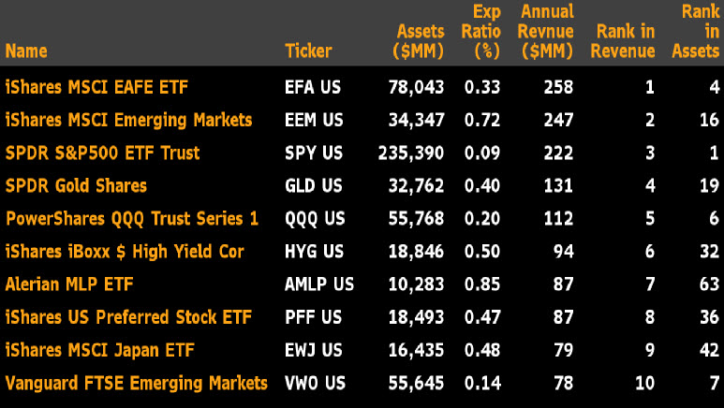
Etfs ranked by revenue generated

Slide 49
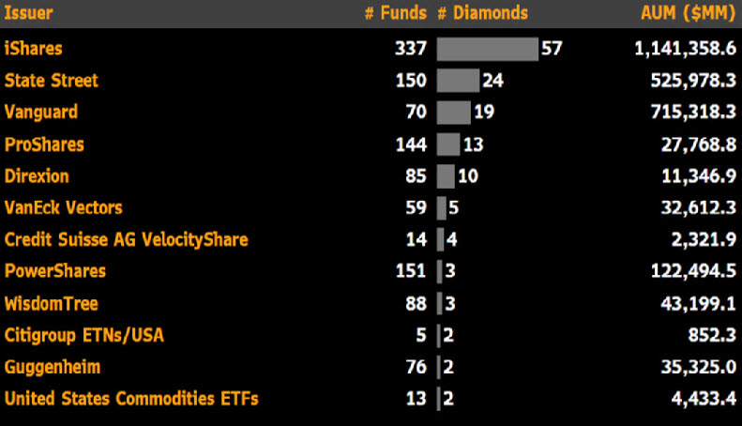
Issuers ranked by ‘diamonds’

Slide 50
Breaking out of oblivion

Slide 51
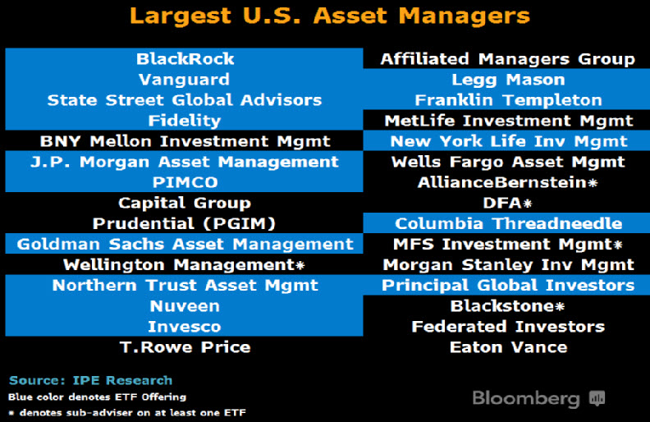
Party still rocking but it’s “BYOA”

Slide 52
The Smart-Beta Spectrum

Slide 53
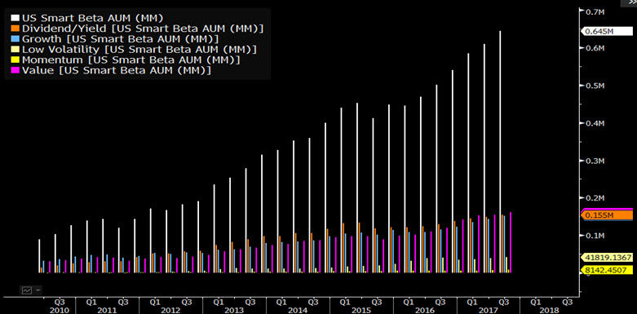
Rise of the machines: smart-beta

Slide 54
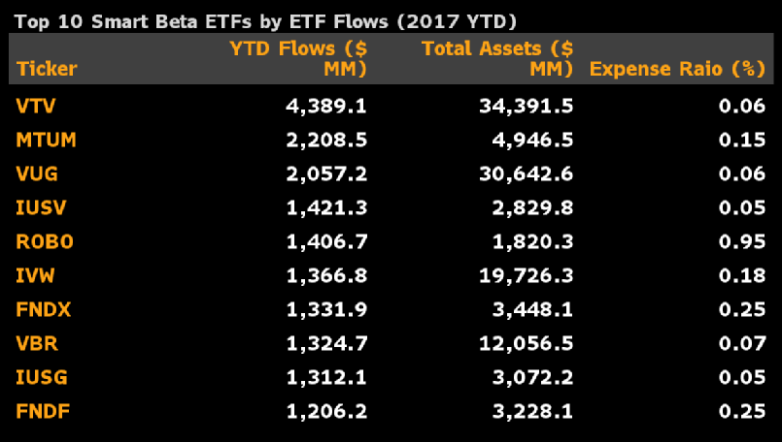
The best selling smart-beta etfs

Slide 55
Some etfs more value-y than others

Slide 56
The smart-beta spectrum

Slide 57
Nasty Surprises

Slide 58
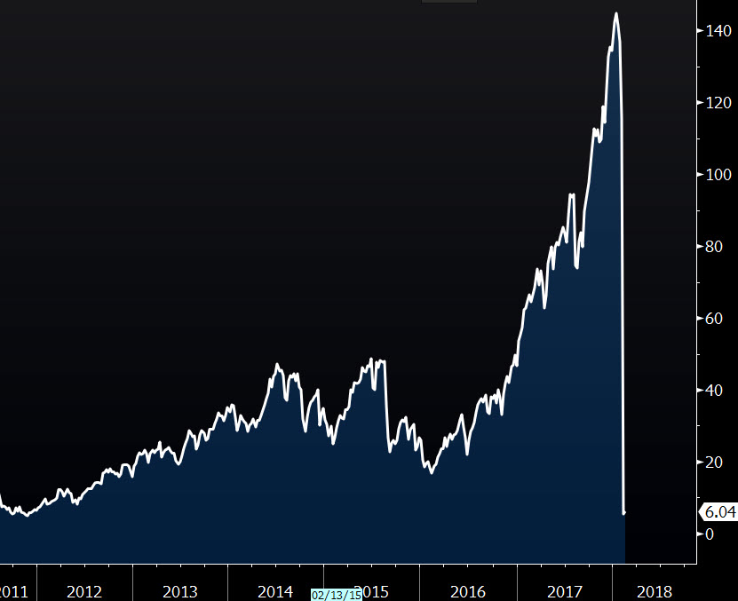
XIV is free fallin’

Slide 59
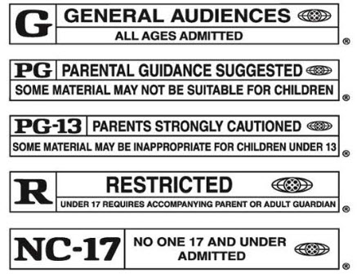
Do etfs need labels or ratings?

Slide 60
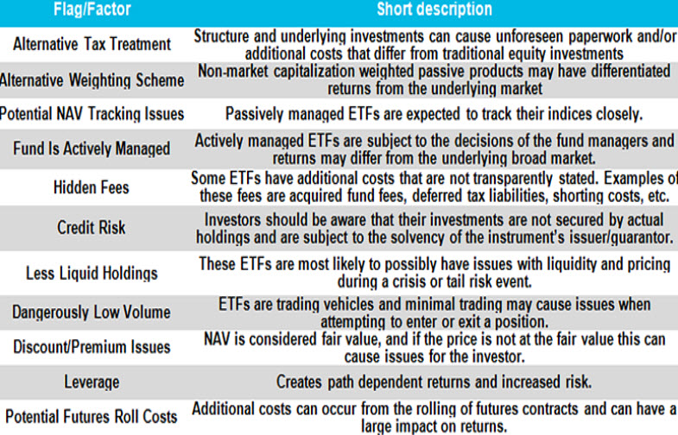
Advanced info of potential surprises

Slide 61
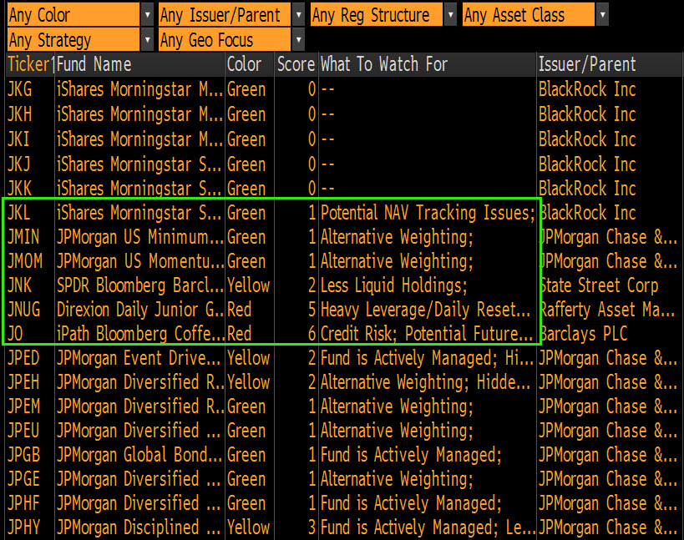
The ETF Traffic Light System

Slide 62
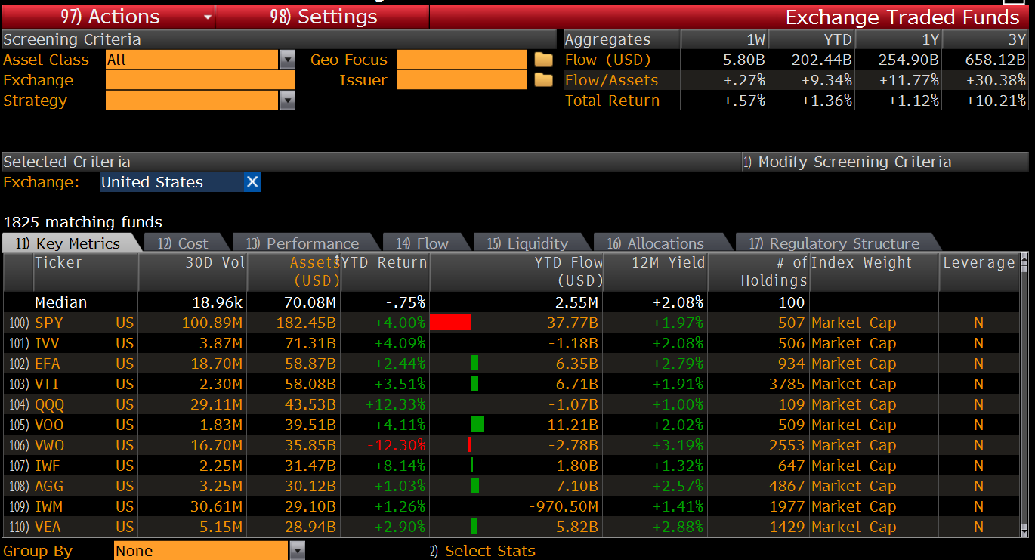
ETF<GO> = Due Diligence

Slide 63
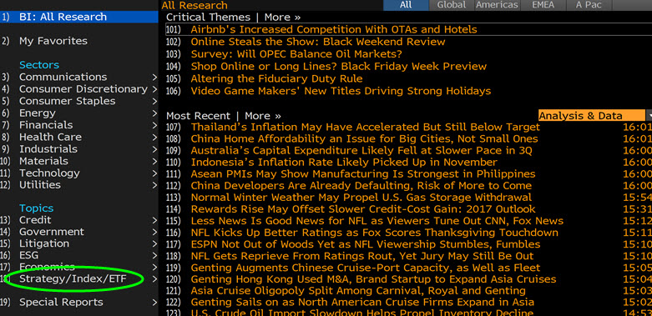
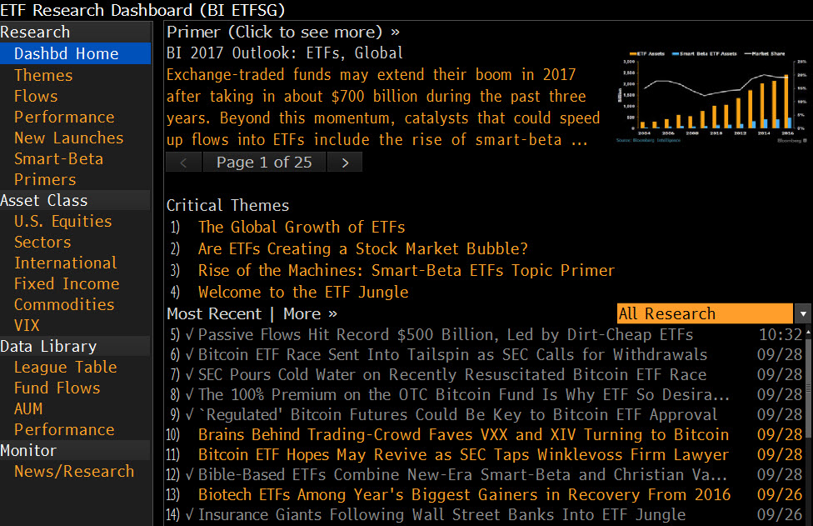
BI <GO> BI ETF<GO>

Slide 64
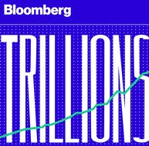
New tv show & podcast

Slide 65
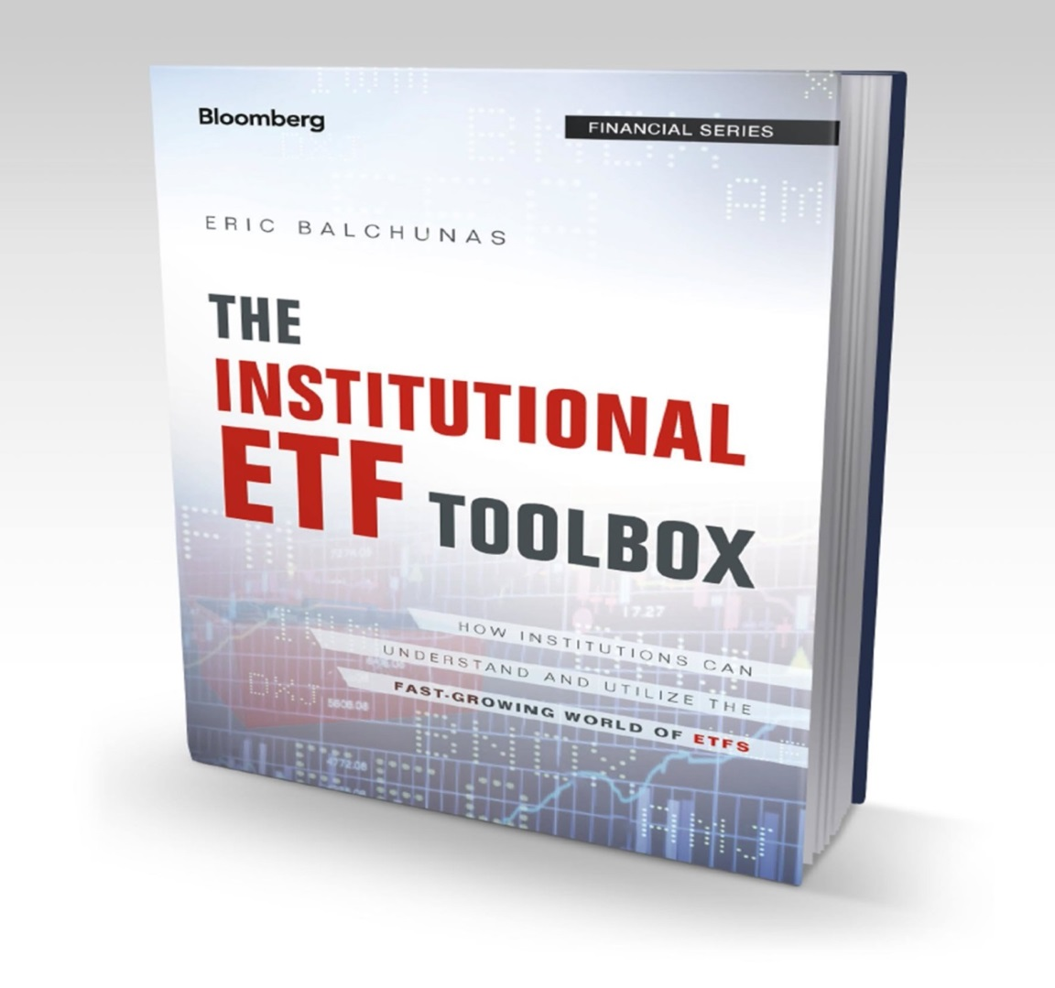
Available on book<go> or amazon.com
Please forgive my shameless promotion…

Slide 66
Thank you
Newsletter: ebalchunas@bloomberg.net
Twitter: @EricBalchunas On Bloomberg: BI ETF<GO>

