Slide 1
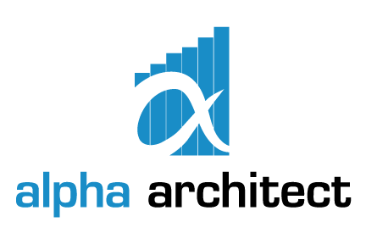
The Business of ETFs
2018 © Alpha Architect. All Rights Reserved.
Measuring the Robustness of US ETF Firms

Slide 2
ETF Firms $1B+ by AUM

Slide 3
Aum vs Revenue
Top 10 by AUM
Top 10 by Revenue
Notes:
Highlight low cost firms moving down. No way is right or wrong, but let’s slow down the talk about low cost firms are eating the industry. They’re certainly doing well on market share, but that is what the low cost firms do in any industry.
If you’re offering value to investors, you can still do well at higher prices. Let take ProShares for example. They have their suite of leveraged products. Leveraged products are mainly trading tools and held for short periods of time. Therefore, investors care about liquidity above all, and care minimally about the expense ratio.

Slide 6
normalized Herfindahl-Hirschman Index Rankings
Rank | Firm | Normalized HHI
1 | KraneShares | 0.5971
2 | ALPS | 0.4825
3 | Columbia | 0.4333
4 | USCF | 0.3679
5 | Deutsche Bank | 0.2995
6 | Virtus | 0.2960
7 | PIMCO | 0.2901
8 | Principal | 0.2628
9 | ETFMG | 0.2495
10 | JPM | 0.2381
11 | Goldman | 0.2087
12 | ETC | 0.2042
13 | State Street | 0.1983
14 | Ark | 0.1955
15 | OFI | 0.1935
16 | Pacer | 0.1918
17 | PowerShares | 0.1892
Rank | Firm | Normalized HHI
18 | VictoryShares | 0.1517
19 | Guggenheim | 0.1486
20 | John Hancock | 0.1447
21 | ETFS | 0.1388
22 | Franklin Templeton | 0.1278
23 | Northern Trust | 0.1226
24 | IndexIQ | 0.1013
25 | Van Eck | 0.0844
26 | Global X | 0.0810
27 | AdvisorShares | 0.0730
28 | Fidelity | 0.0656
29 | Wisdomtree | 0.0650
30 | Direxion | 0.0454
31 | ProShares | 0.0437
32 | Vanguard | 0.0368
33 | Schwab | 0.0295
34 | iShares | 0.0265
35 | First Trust | 0.0264
Notes:
Think about how to visualize and highlight what you want to note. KraneShares growing rapidly, so not a bad thing that they’re concentrated. Acquisition target?

