Slide 1
ETF Short Interest and Failures-to-Deliver:
Naked Short-selling or Operational Shorting?
Richard Evans¹, Rabih Moussawi²,
Michael Pagano², John Sedunov²
¹Darden School of Business
²Villanova U.

Slide 2
Regulatory Concerns
Securities and Exchange Commission (2015):
“Short selling is extreme in many ETFs. The lending markets are not being properly utilized to accommodate the selling, causing systemic risk from undisclosed leverage in the financial system (more shares sold than exist) for the benefit of very few while creating risks for all stakeholders, including taxpayers.”
Example: FINRA case (April 2015) against Scout Trading and Wedbush Securities re: manipulative trading strategies with 14 leveraged and inverse-leveraged ETFs (based on prolonged short-selling & FTDs).

Slide 3
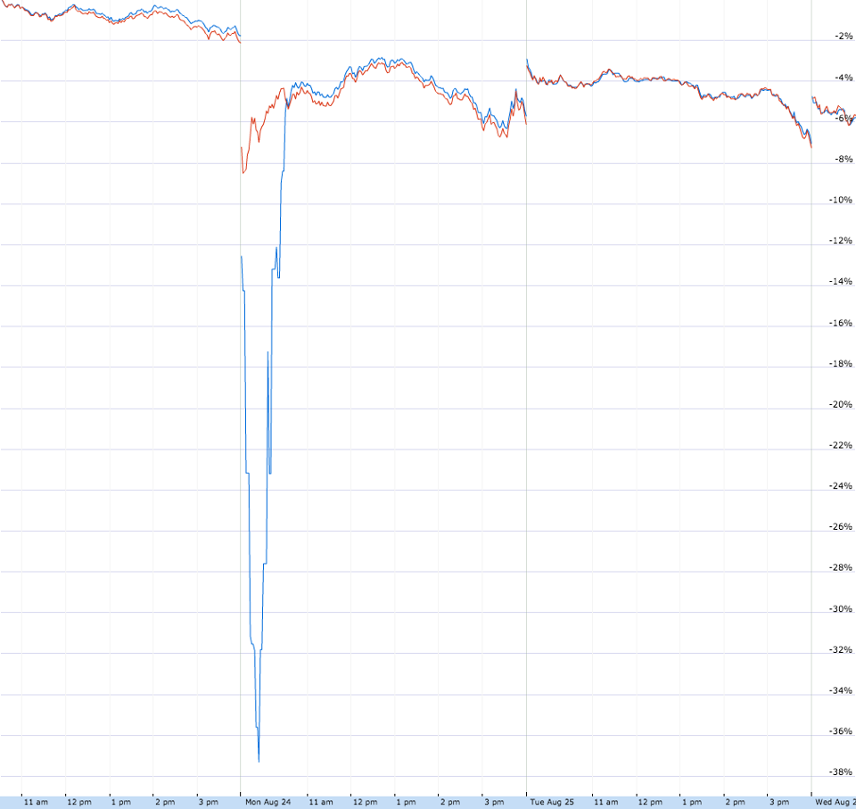
Regulatory Concerns (2)
Financial Stability Board (2011):
“…the expectation of on-demand liquidity may create the conditions for acute redemption pressures on certain types of ETFs in situations of market stress.”
Example: Forbes headline –
“What the E-T-F happened on
August 24th?”
Red = SPY (VW S&P 500)
Blue = RSP (EW S&P 500)

Slide 4
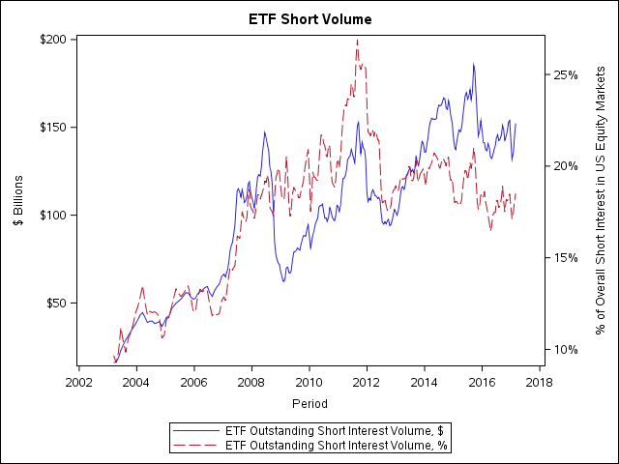
Growing Short Interest in ETFs

Slide 5
Failure to Deliver (FTD)
FTD - a condition where two investors agree to the purchase/sale of a security at a given price but the seller fails to deliver the security in a timely manner.
Stock sale (T)
Deliver shares (T+3)
If not, FTD (T+3)
Must cover (T+4 or T+7)
Stocks bought and sold must be settled within 3 days (or T+6 for “bona fide” market makers)
  FTD = Open Interest of Undelivered Positions, observed at T+3, after actual trades at T
Deliberate fail to deliver: profit from short exposure (“strategic fails”)
  Naked short selling has “cost investors $100 billion and driven 1,000 companies into the ground” per SEC comment letter
In Sept 2008, SEC Rule 204T
  Mandated stock borrowing arrangements prior to short selling
  Close-out requirement on next business day
  FTDs arising from long sales or market maker FTDs were given three additional days

Slide 6
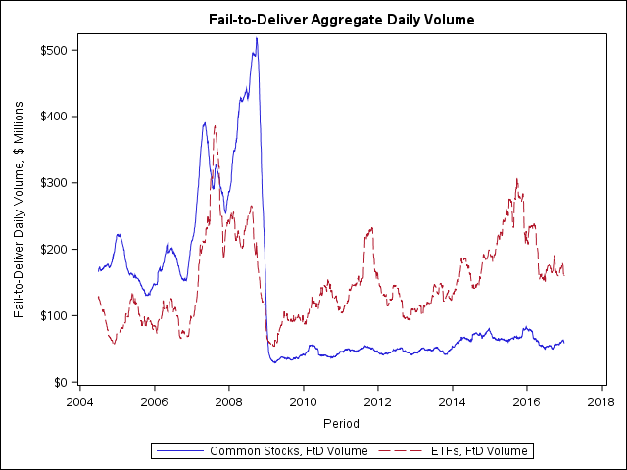
FTD trends for Stocks and ETFs
Sec Rule 204T

Slide 7
ETFs’ FTDs are growing since 2009 and exceed 0.5% SEC threshold
ETF FTDs are now 78% of all FTDs

Slide 8
Excerpt from August 2015 Comment Letter to the SEC regarding FTDs and ETFs

Slide 9
Research Questions and Results
What is driving ETF FTDs?
  Prior research shows Stock FTDs driven by naked short selling
  We identify an alternative reason for ETF FTDs: operational shorting
We propose a novel measure of “operational shorting”
Operational Shorting is related to increased ETF Short Interest and FTDs
What is the impact on the liquidity of an ETF’s underlying basket?
  Operational Shorting acts as a “buffer” and improves the basket’s liquidity
“Spillovers” can occur between AP-level and market-wide operational shorting
We also examine the relationship of ETF FTDs and financial markets:
    It doesn’t predict future risk-adjusted returns (consistent with liquidity provision rather than bearish bets)
    It does predict the St. Louis FSI, a measure of counterparty/systemic risk, (post-2009)

Slide 10
Key Takeaways from our results
ETF shares are not created immediately: “option to delay” is valuable due to order imbalances
Option to delay ≈ Operational Shorting
ETF FTDs are due primarily to operational shorting
ETF short interest contains operational shorting and serves as a liquidity provision mechanism
  The incentives for AP / MM are arbitrage profits
But… the aggregate operational shorting activity can adversely affect market-wide financial stability
Spillovers of FTDs between APs and Financial Leverage can lead to financial instability

Slide 11
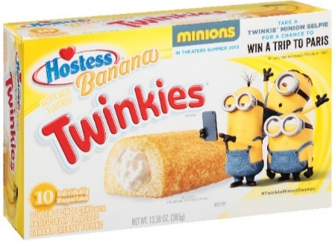

How does AP market work? Twinkie arb….
$3/box of 10
At my school, I could sell them for $0.50/twinkie
What is the arbitrage strategy and profits?
Buy box, open and sell individual twinkies
Profit = -$3 + 10*$0.50 = $2
Profit = -$3 + 9*$0.50 = $1.50

Slide 12
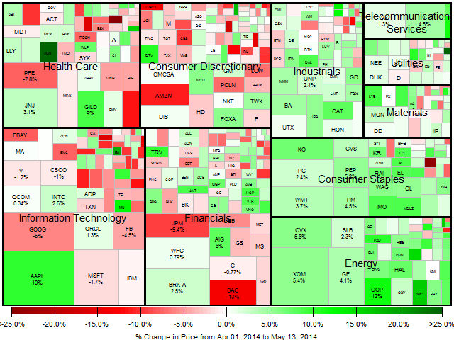
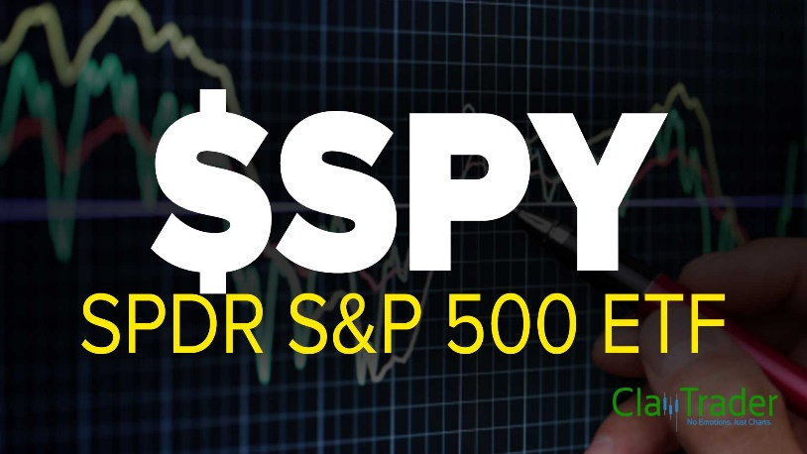
Authorized Participants and ETF arbitrage….
Market Price = $215.57
Basket NAV =$217.46
What is the arbitrage strategy and profits?
Buy ETF and sell basket of stocks
Profit = -$215.57 + $217.46 = $1.89
Profit = (-$215.57 + $217.46 – Trading Cost)*Creation Unit Size – Creation Fee

Slide 13
What can an Authorized Participant do?
When faced with “excess buying” pressure for ETF shares, the AP has two choices:
  Sell shares from its inventory or locate the shares in the secondary market (and deliver at T+3).
OR
  Sell shares “naked” and then locate or create the shares at a later time (up to T+6 for “bona fide” market making).
The first choice locks in a market-making profit but requires higher upfront capital outlays (safer but lower return).
The second choice can also lock in a profit (if a futures/options hedge is used) but with less capital outlay (safe and higher return).

Slide 14
Example of Operational Shorting: ITOT

Slide 15
Example of Operational Shorting: ITOT

Slide 16
Example of Operational Shorting: ITOT
Why doesn’t ETF share creation respond perfectly to excess buying/selling?
Creation unit size
Creation fee
Trading costs
Trading environment or market liquidity
Persistent Oper. Shorting > 0
Increased FTDs

Slide 17
Measuring Operational Shorting
Our daily measure of operational shorting imbalance and the change in shares outstanding over a 3-day rolling window:
Uses the Ellis, Michaely, and O’Hara (2000) method to sign all trades on a millisecond basis and then sums all signed trades at 4:00 pm for each day.

Slide 18
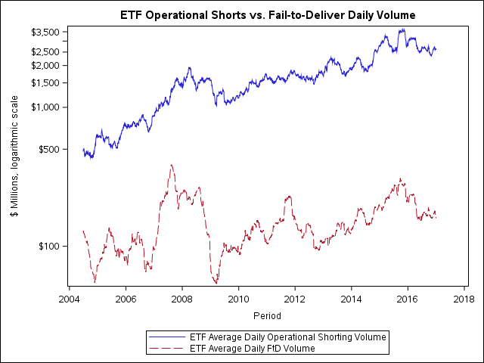
Increased Operational Shorting and FTDs

Slide 19
Operational Shorting Reduces ETF Mispricing

Slide 20
Operational Shorting Reduces Underlying Stocks’ Spreads

Slide 21
Operational Shorting Increases Counterparty/Systemic Risk

Slide 22
Conclusions
SEC rules have reduced overall FTDs but are growing for ETFs since 2009 (counter to trends in Stock FTDs).
We propose a new possible source of ETF FTDs, Operational Shorting.
Operational Shorting can reduce ETF mispricing (+).
Operational Shorting can improve the underlying basket’s liquidity (+).
But… it can also increase market-wide financial stress (-).
We show this market-wide stress is related to market maker “spillovers” and these firm’s financial leverage.
No Free Lunch… ETF market-making has both benefits and costs to society.

