Slide 1
Discussion: ETF Short Interest and Failures-to-Deliver: Naked Short-selling or Operational Shorting?
Jack Vogel, PhD
T: +1.215.882.9983
F: +1.216.245.3686
ir@alphaarchitect.com
213 Foxcroft Road
Broomall, PA 19008

Slide 2
Overall – great descriptive paper!
Paper Documents three items:
What is operational shorting for APs within ETFs
That operational shorting not predictive of future stock performance
Papers on non-operational shorting find a connection
It may increase counterparty/systematic risk
Three Suggestions:
Dig deeper (or eliminate) the systematic risk section
What are penalties for failing Reg-SHO
What are effects on results if one pulls out an individual AP firm?

Slide 3
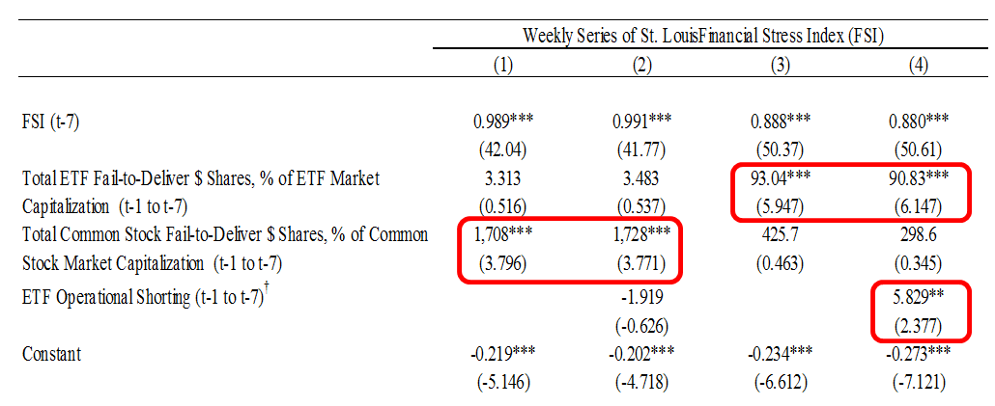
1) Increased Financial Stress – what does this mean?
“However, the potentially harmful effects of FTDs on market-wide stress have not been completely removed because, as is evident in the post-crisis period, FTDs for ETFs are growing and now have a positive and significant impact on the FSI measure. Thus, the potential source of stress on the financial system appears to have shifted from common stocks during the pre-crisis period to ETFs during the post-crisis period.”
→ Spillovers and Leverage
Could being short $2.5bn, relative to a $30 trillion market-cap, cause distress?
Assumption: ~ 2,000 ETFs, each short around 25,000 shares (1/2 or 1/4 of a create; assume 3 APs active in an ETF), and the average price is $50
Result: operational shorting = 2,000*25,000*$50 = $2.5 bn!
What are the implications and effects?

Slide 4
1) Increased Financial Stress?
“Similar to the results for FTDs, we find that a lead market maker’s other operational shorts are positively related to an individual ETF’s operational shorting activity and the Overall Market-wide Operational Shorts also exhibit a positive relation with an individual ETF’s operational shorting”
Shouldn’t we expect this, ex-ante?

Slide 5
2) Appears Rational to “wait to create” – what are penalties?
In addition, Rule 203(b)(3) of Regulation SHO requires that participants of a registered clearing agency must immediately purchase shares to close out failures to deliver in securities with large and persistent failures to deliver, referred to as “threshold securities,” if the failures to deliver persist for 13 consecutive settlement days. Threshold securities are equity securities that have an aggregate fail to deliver position for five consecutive settlement days at a registered clearing agency (e.g., National Securities Clearing Corporation (NSCC)); totaling 10,000 shares or more; and equal to at least 0.5% of the issuer's total shares outstanding. As provided in Rule 203 of Regulation SHO, threshold securities are included on a list disseminated by a self-regulatory organization (“SRO”). Although as a result of compliance with Rule 204, generally a participant’s fail to deliver positions will not remain for 13 consecutive settlement days, if, for whatever reason, a participant of a registered clearing agency has a fail to deliver position at a registered clearing agency in a threshold security for 13 consecutive settlement days, the requirement to close-out such position under Rule 203(b)(3) remains in effect.
Source: https://www.sec.gov/investor/pubs/regsho.htm

Slide 6
3) Sample Results
What happens to the results if you pull out one AP?
Maybe introduce AP-fixed effects

Slide 7
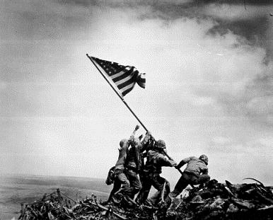
Questions?
T: +1.215.882.9983
F: +1.216.245.3686
ir@alphaarchitect.com
213 Foxcroft Road
Broomall, PA 19008

