Slide 1
«How to use factors»
Discussion by Elisabetta Basilico
March 2018

Slide 2
THE INGREDIENTS: THE FACTOR ZOO
Which factors are significant?
“Half the financial products (promising outperformance) that companies are selling to clients are false” (Harvey, 2017)
…..and the Cross-Section of Expected Returns (Harvey 2015)
Factor Based Investing: The Long Term Evidence (Dimson et al., 2017)

Slide 3
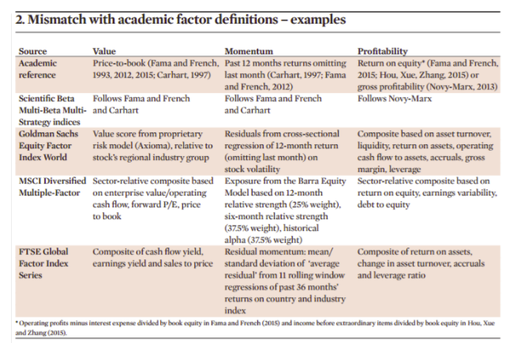
THE INGREDIENTS: THE FACTOR ZOO
Are products pure to those factors?
Extract from Ducoulombier et al., 2016

Slide 4
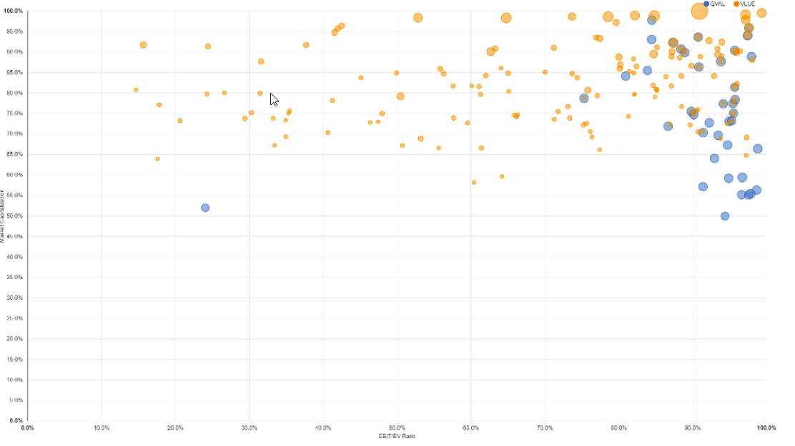
THE INGREDIENTS: SOLUTIONS
General Rule: DON’T BUY an ETF BASED on its NAME

Slide 5
THE RECIPE: THE DEVIL IS IN THE DETAILS
Academia is not focusing on constraints, # of securities, rebalance frequency
Asset managers do not discuss these details, unless you ask…and when you ask you realize that everyone has their own method.

Slide 6
THE RECIPE: SOLUTION
REBALANCING TIMING and concept of “TIMING LUCK”= the variance between the returns of two different managers implementing the same strategy with different rebalancing days
Hoffstein proposes the concept of overlapping portfolios as a solution to reduce this uncompensated risk (Jegadeesh and Titman, 1993)

Slide 7
OPEN QUESTIONS
The article uses an “extreme” example ( 100% cash-100% equity). What happens if changes are more gradual and incremental? Are the differences in results still big?

Slide 8
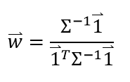
OPEN QUESTIONS
1/N as the closed form solution of is based on the assumption that the correlation matrix is symmetric circulant. Is it always true?
In a simple exercise using F-F momentum factors we did not find it to be true.

Slide 9
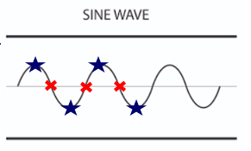
OPEN QUESTIONS
The assumption that the long-short portfolios have zero expected returns is very specific. Think about this situation:
100% cash or 100% long or 100% short a single stock based on prior performance + the market is a deterministic process represented by a sine wave
The first manager has a negative expected return while the second one will be 100% cash forever

Slide 10
THANK YOU

