Slide 1
Presented by
Barry Ritholtz
Chairman, CIO
Ritholtz Wealth MGMT
Democratize Quant
MARC
March 22, 2018
The Fine Art of Failure
An ongoing, continuing, never-ending, work in progress…

Slide 2
Today’s Discussion
Anecdotes & Definitions
Learning via Teaching
Succeeding Obscurely
Failing Obviously
Greatest Failures
Ritholtz Wealth Management

Slide 3
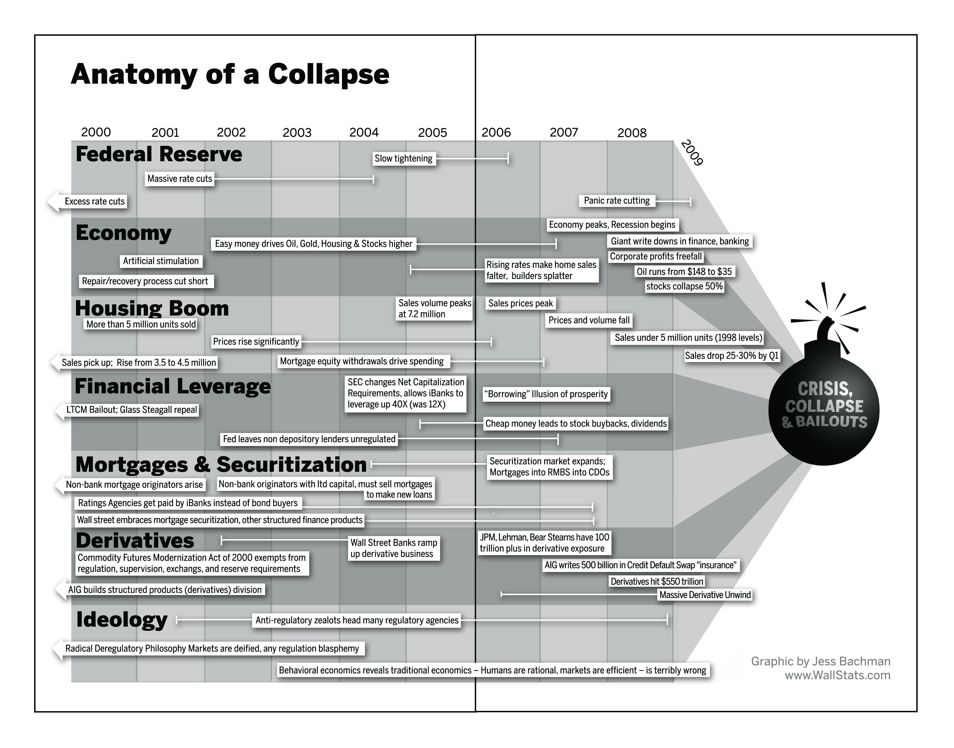
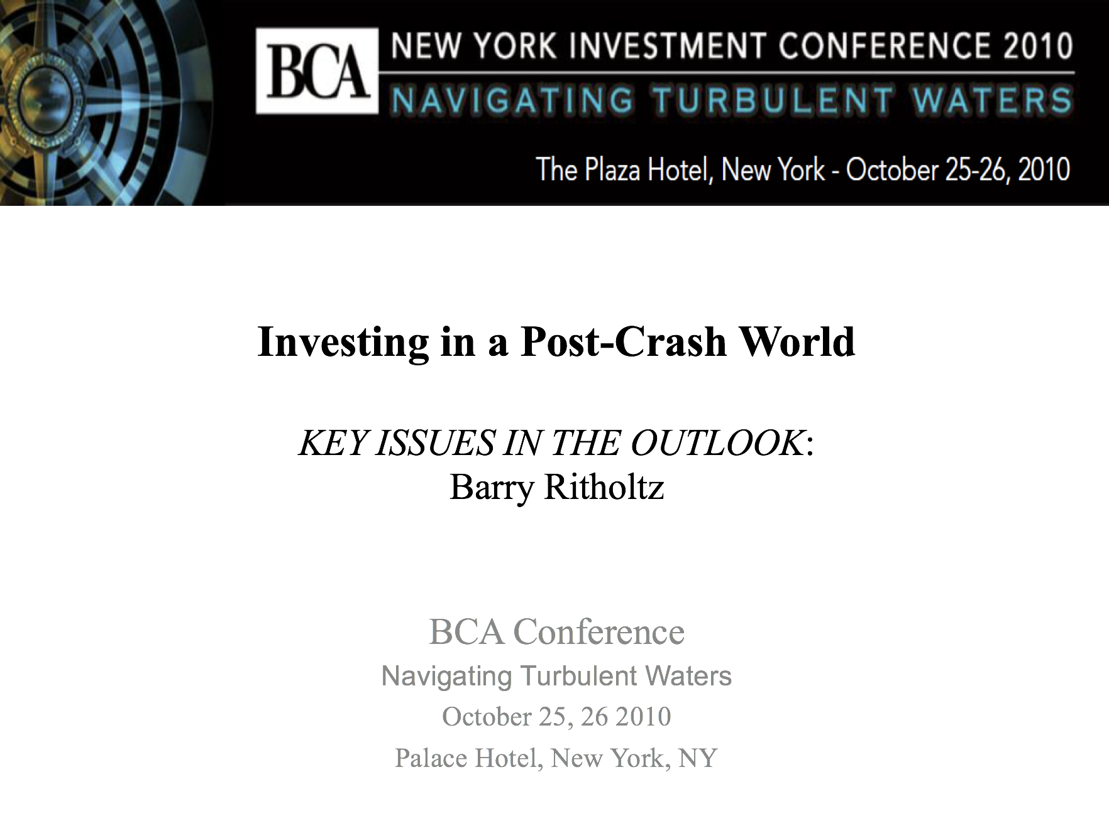
Bailout Nation: Investing in a Post-Crash World
Ritholtz Wealth Management

Slide 4
Thinking About How to Fail
Ritholtz Wealth Management
Ritholtz Wealth Management

Slide 5
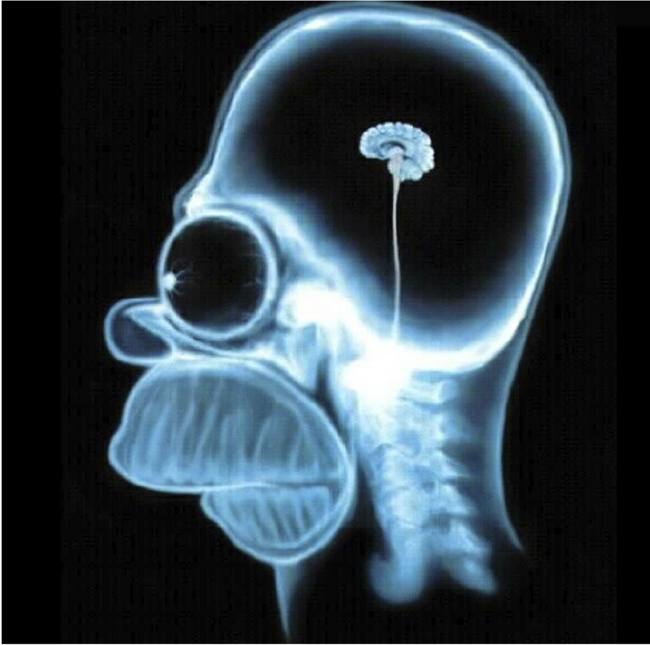
This is Your Brain on Stocks
This
is
your
brain
on
stocks
Ritholtz Wealth Management
Notes:
Thank you for having me.

Slide 6
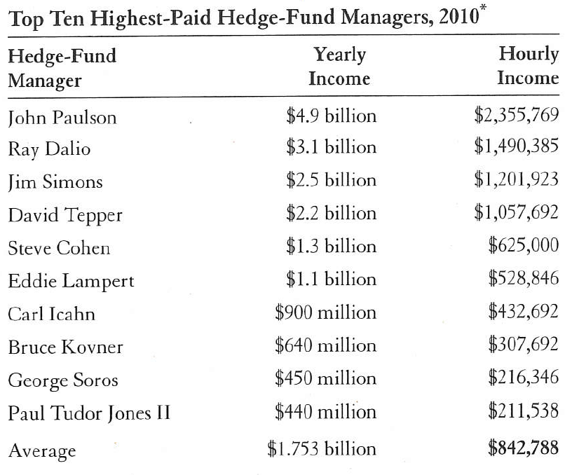
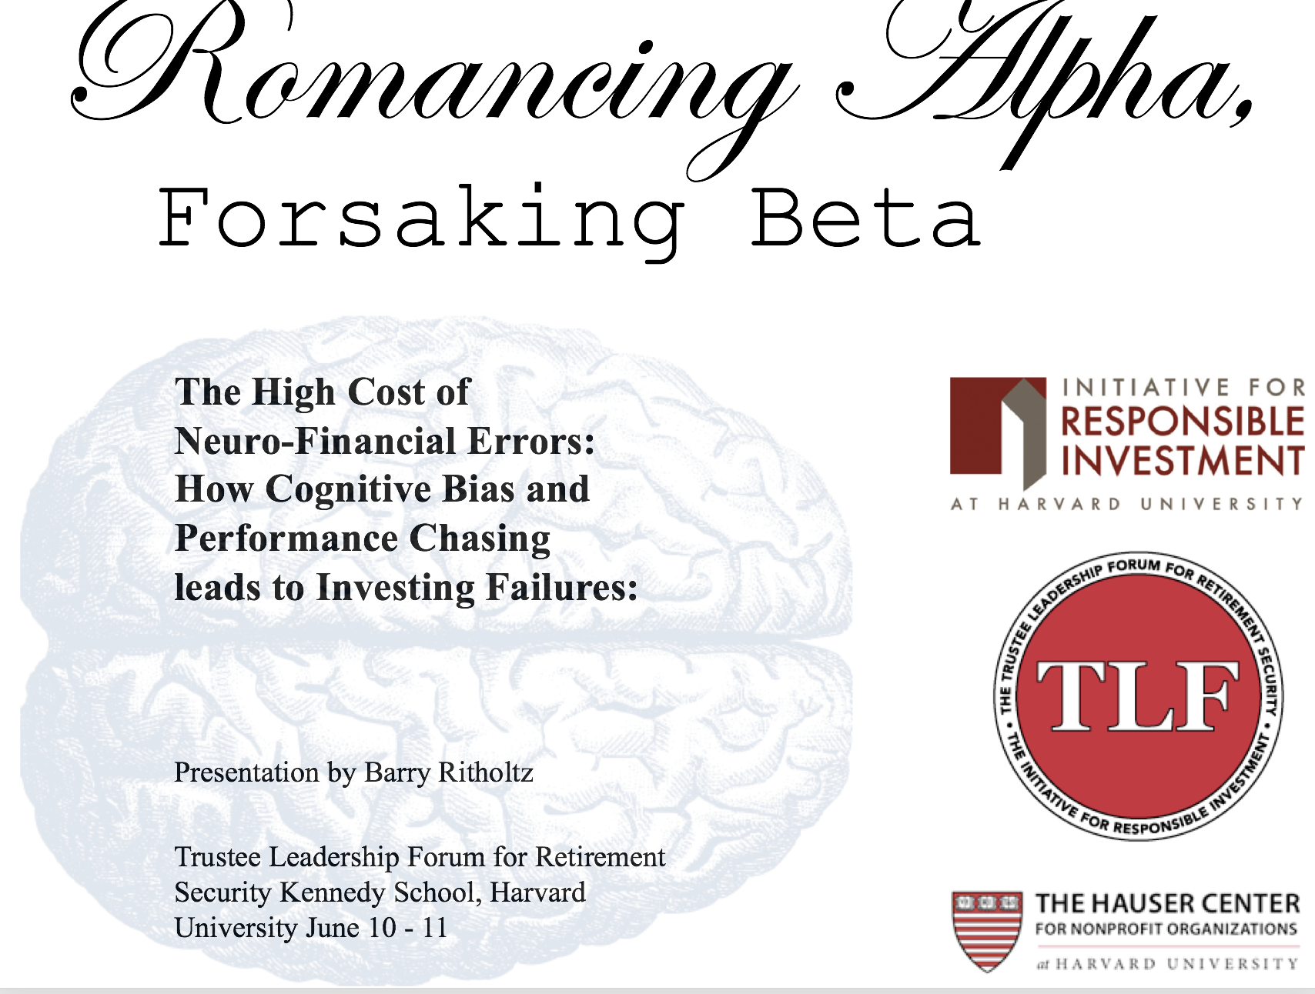
Romancing Alpha, Forsaking Beta
It takes the average family 18.5 years to make
what these hedge fund managers make in 1 hour
Ritholtz Wealth Management

Slide 7
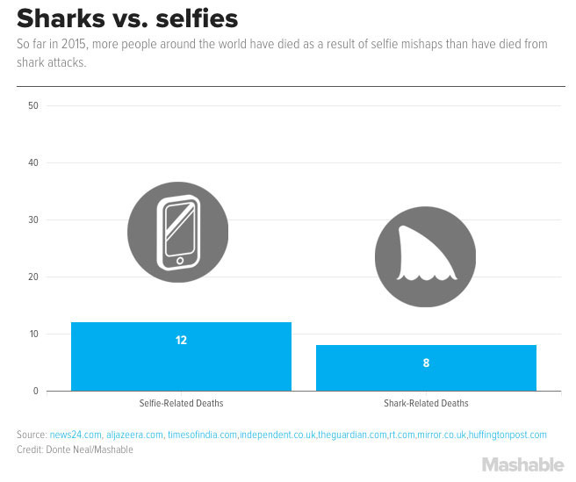
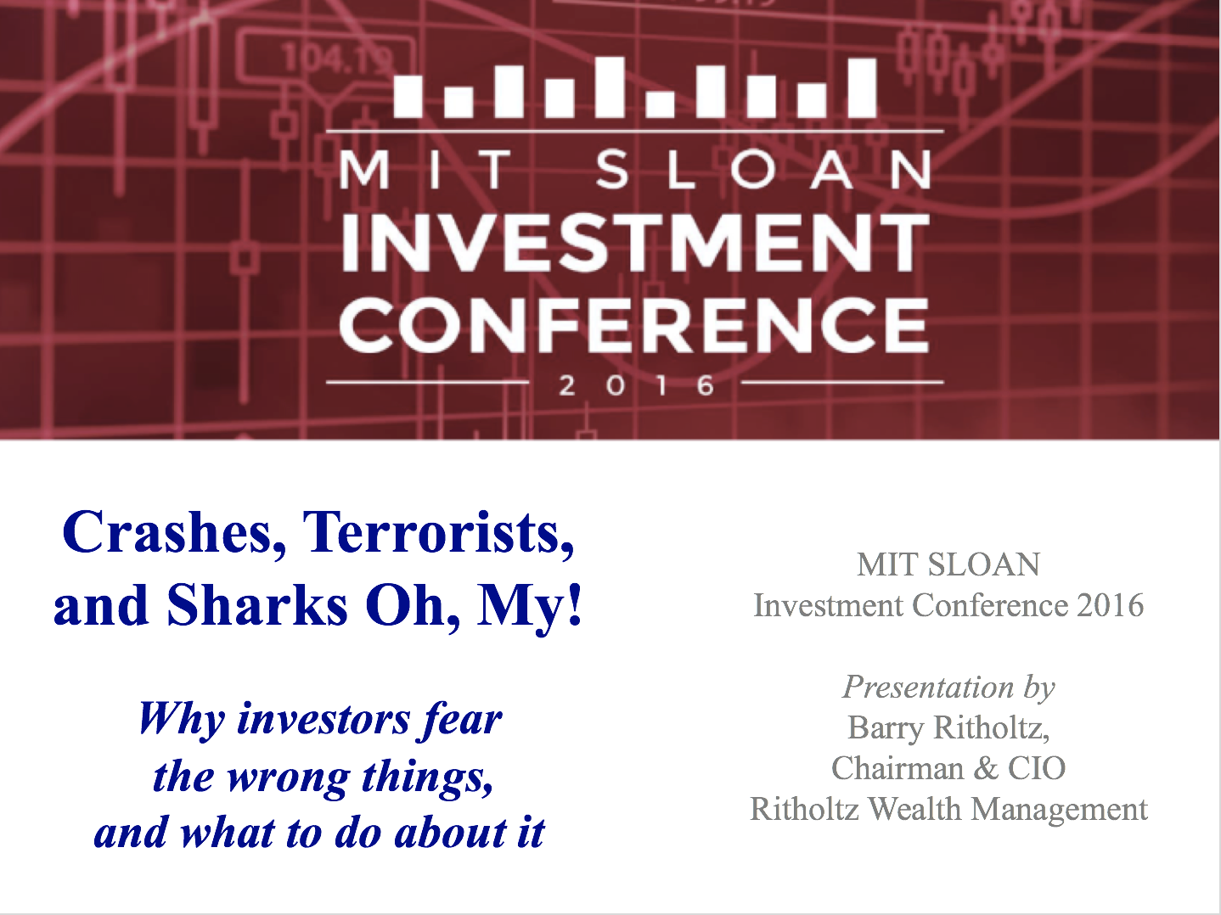
Misunderstanding Risk
Ritholtz Wealth Management

Slide 8
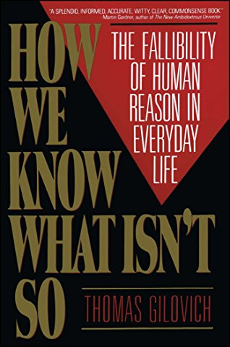
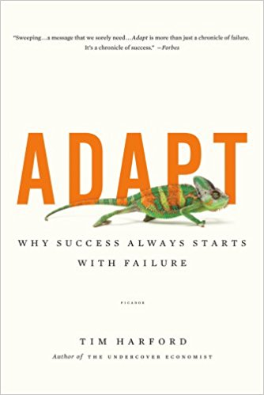
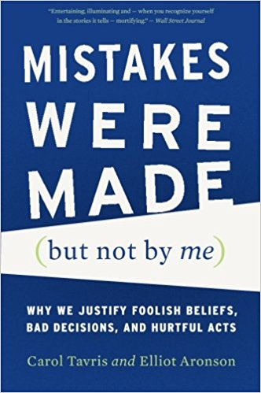
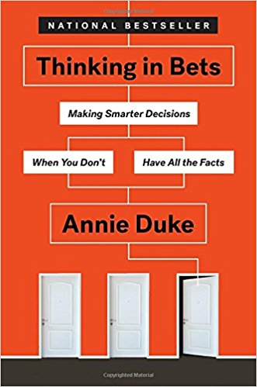
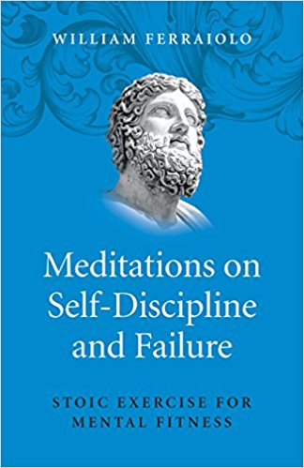
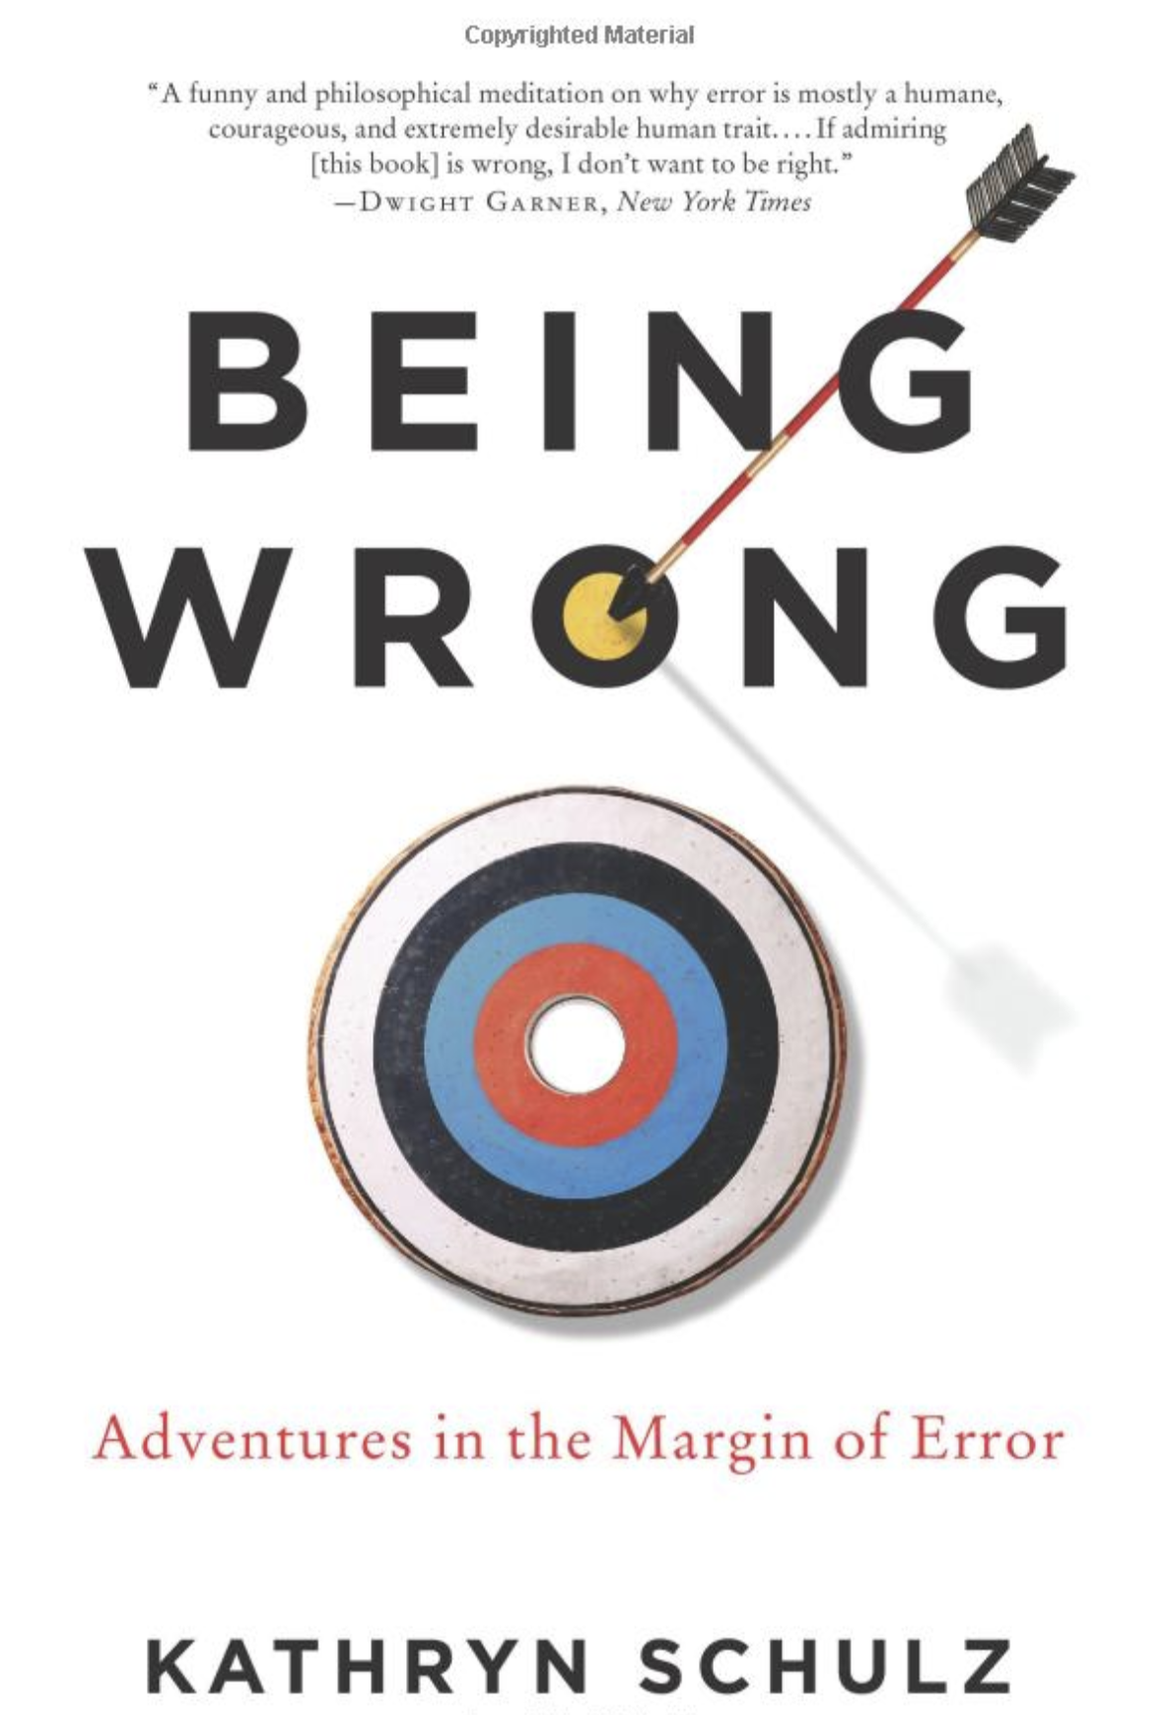
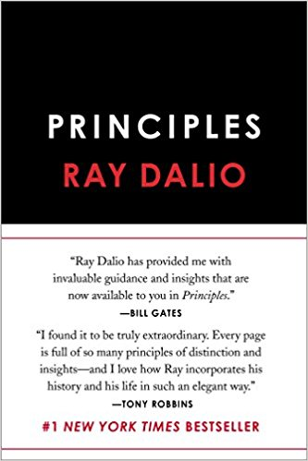
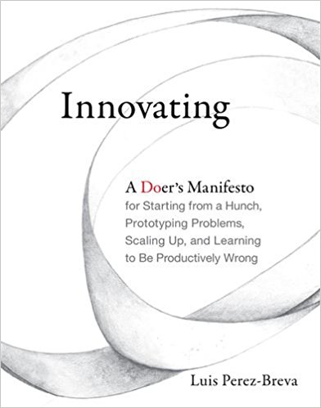
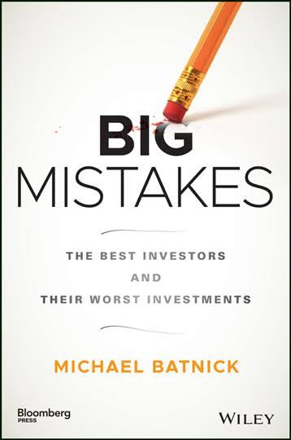
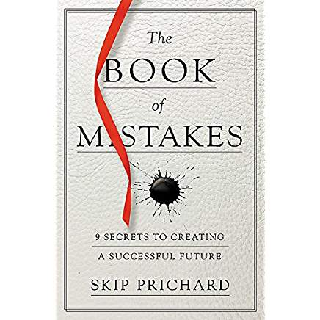
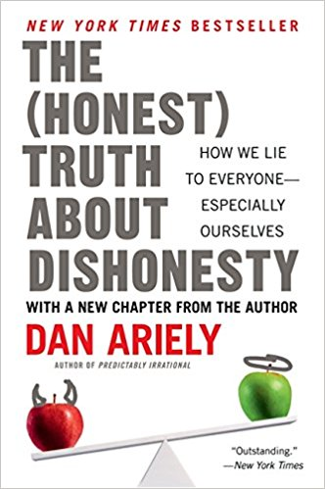
Failure: A growth industry
Ritholtz Wealth Management

Slide 9
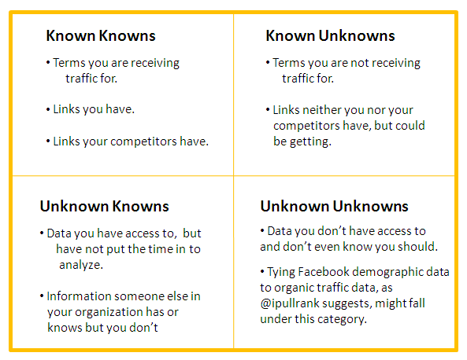
Things To Be Wrong About
1. Objective Reality
2. Meta-Cognition
3. Assumptive Forecasting
Ritholtz Wealth Management

Slide 10
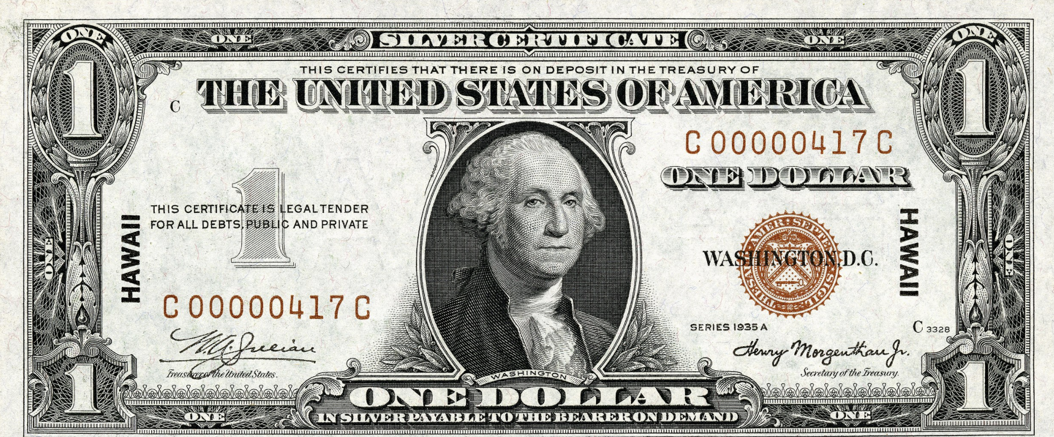
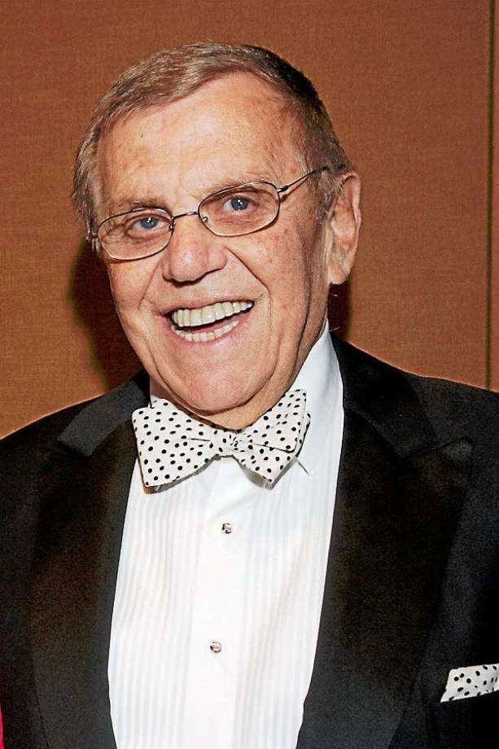
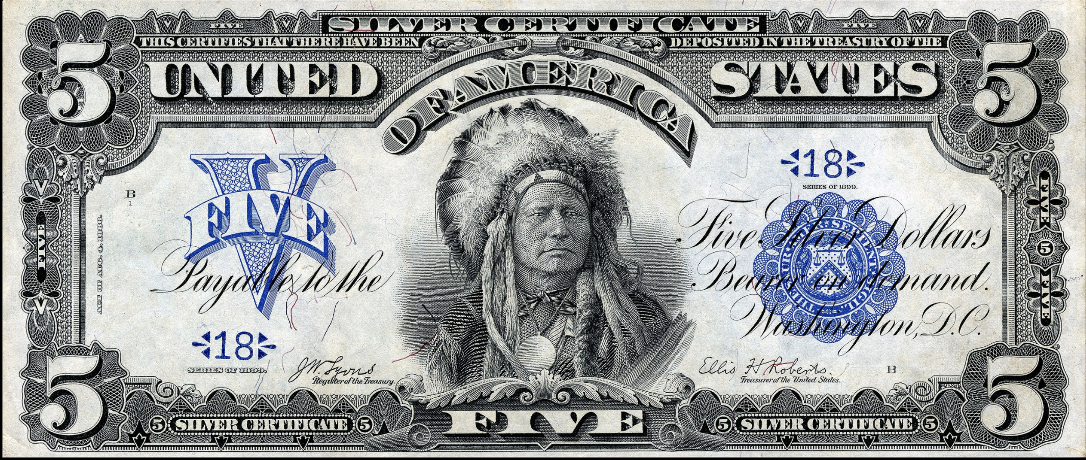
Success = seeing reality when no one else notices
Dr. Henry Jarecki
Silver Certificates
Ritholtz Wealth Management

Slide 11
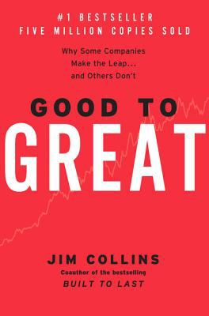
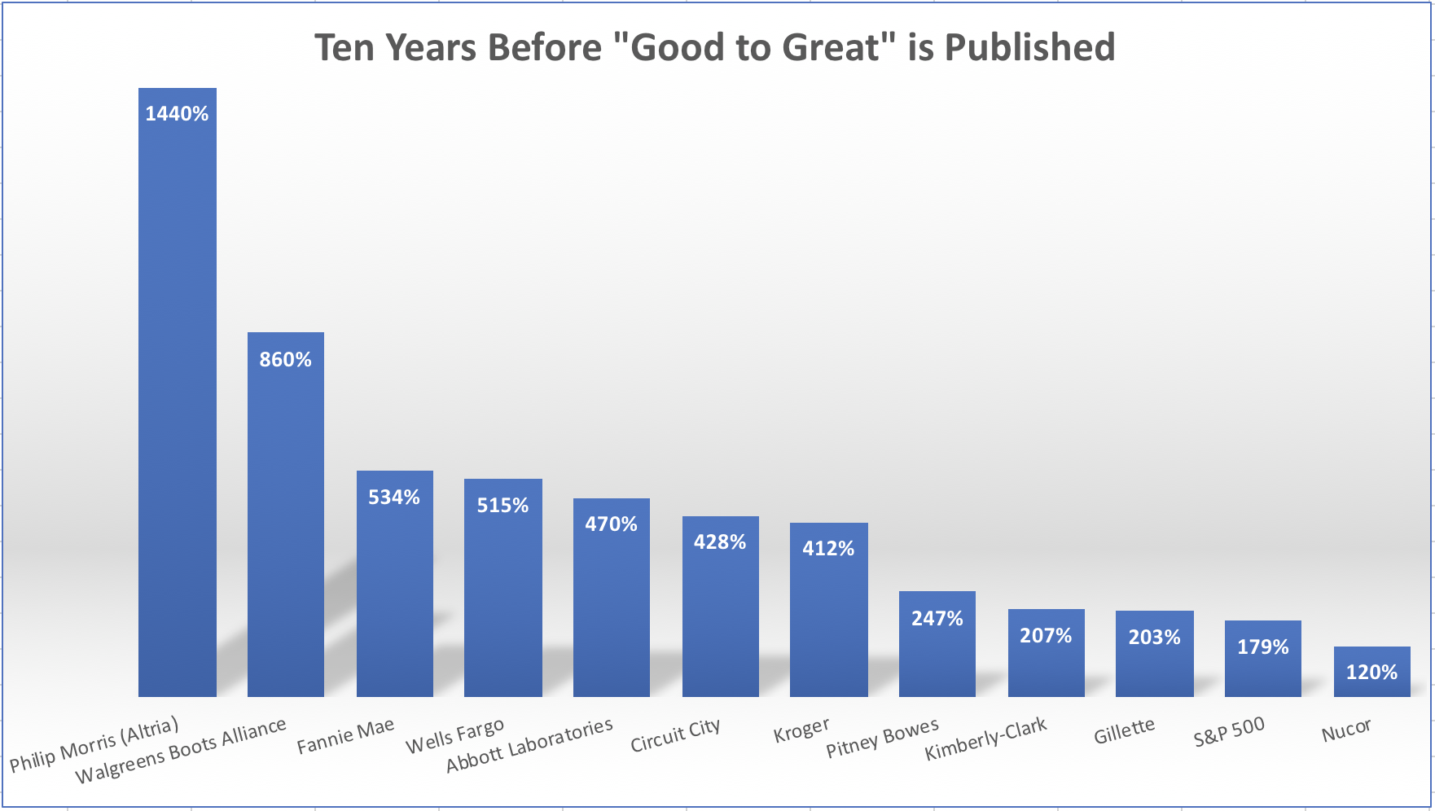
Failure: Misinterpreting the Obvious
11 Companies discussed in Good to Great also include Gillette, which was taken over by Procter & Gamble in 2005, and Philip Morris, which changed its name to Altria
Ritholtz Wealth Management

Slide 12
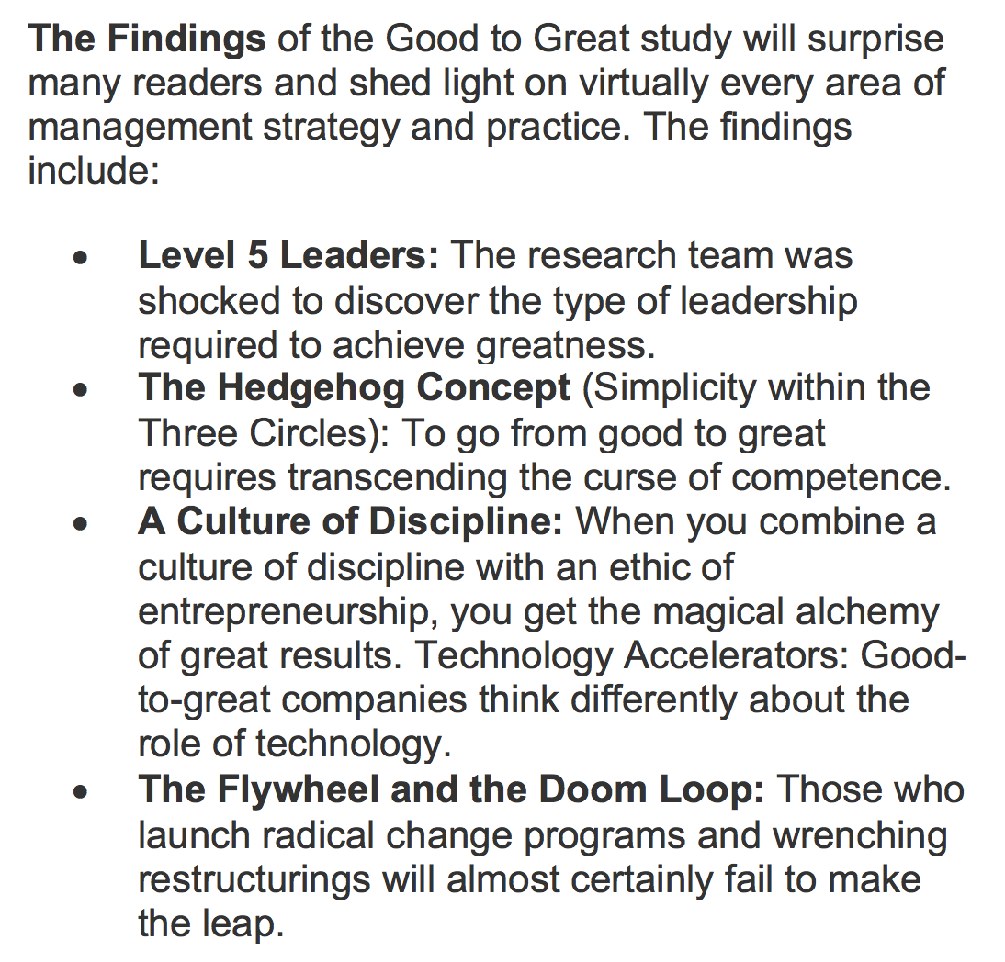
Great . . . or Gimmick ?
Ritholtz Wealth Management

Slide 13
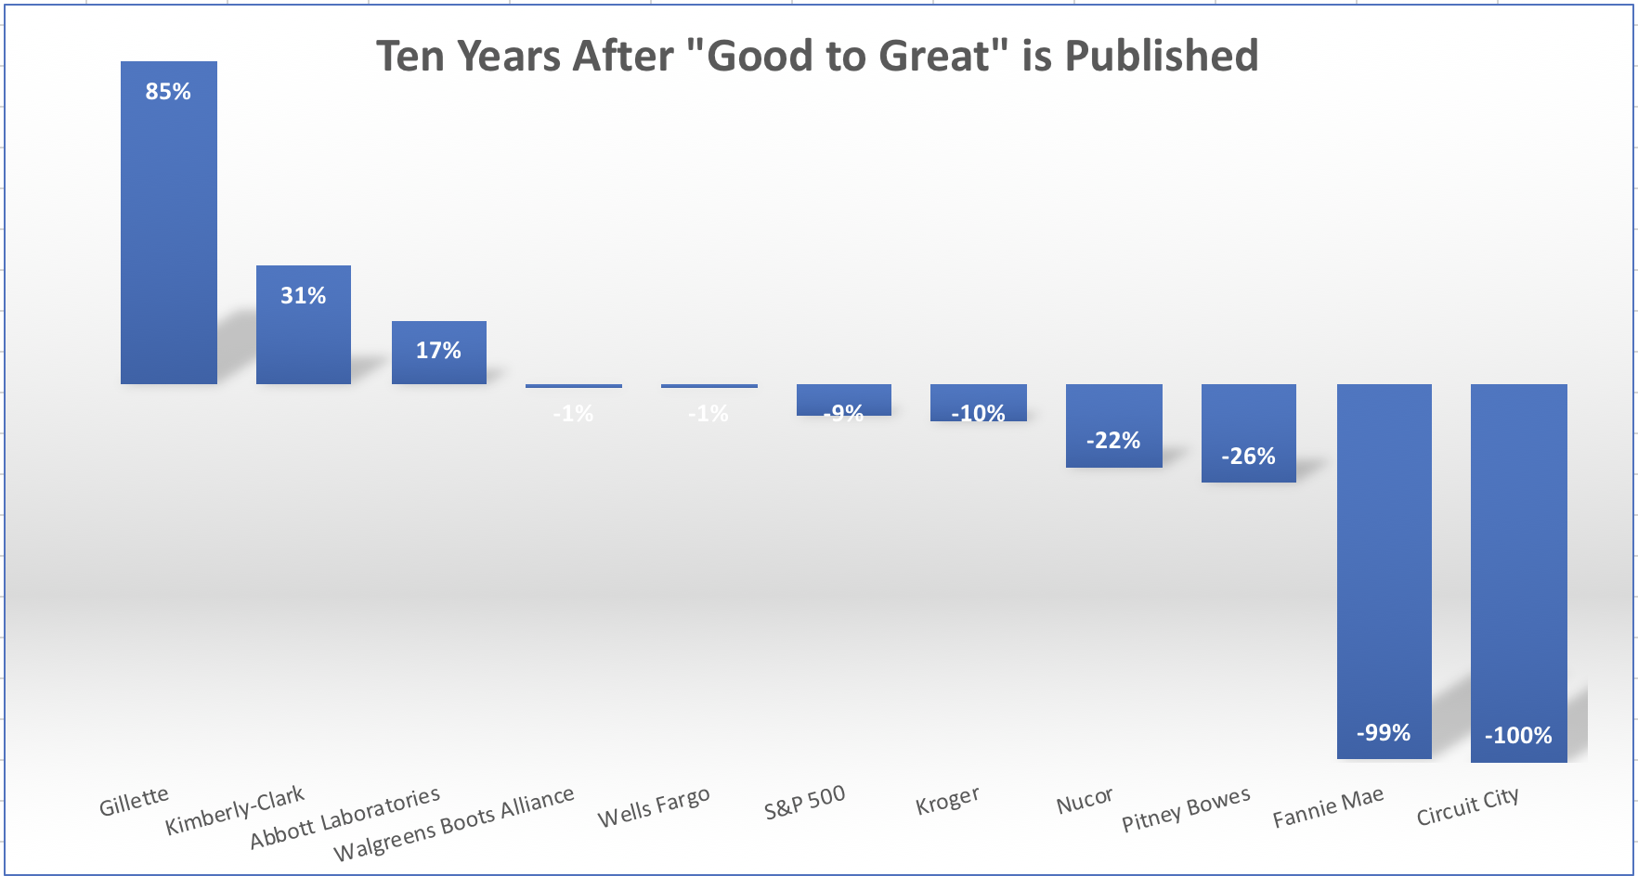
. . . Not Built to Last
Ritholtz Wealth Management

Slide 14
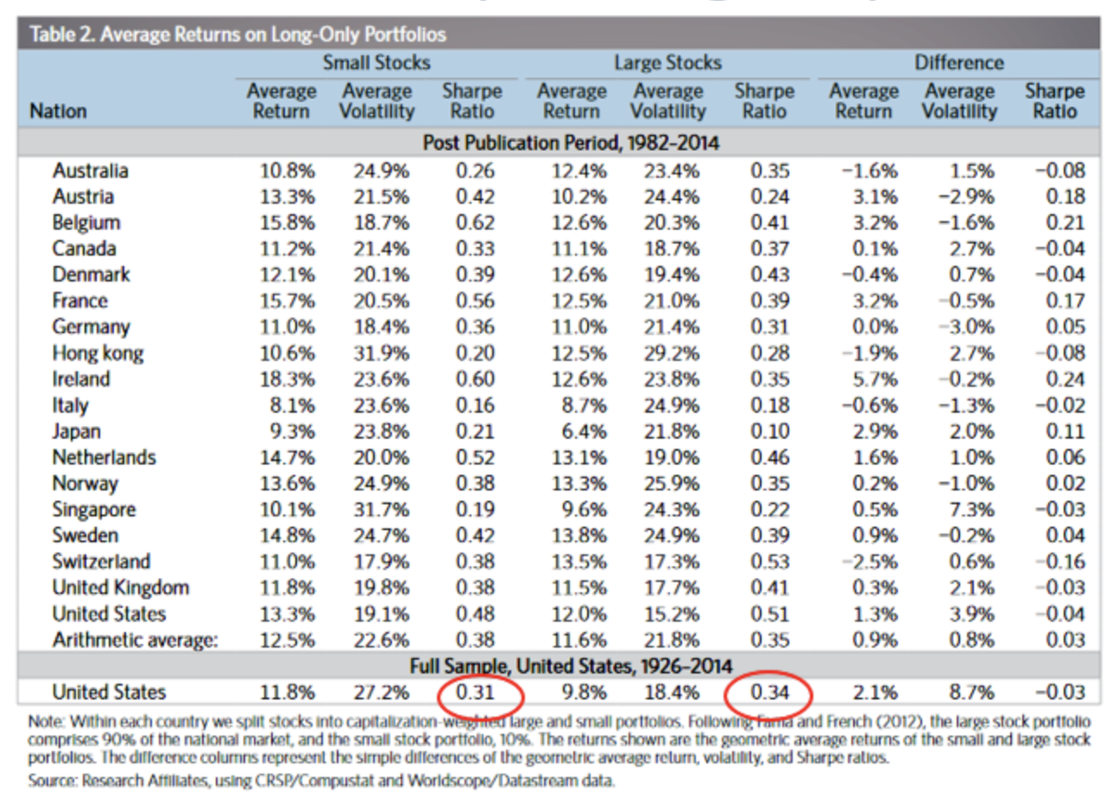
Mandatory Factor Zoo Slide
Ritholtz Wealth Management

Slide 15
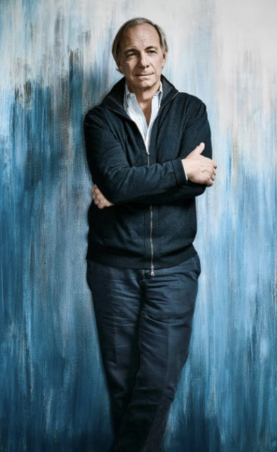
Wrong Like Ray
Mistake-based learning: View mistakes as opportunities to improve.”
Fail Well: own your errors; never hide them, but bring them forward to create a learning opportunity.
Pain + reflection = progress. The “pain of failure” should lead to reflection, from which your wisdom derives.
Systemize: Track what you do; keep improving from your mistakes.
Ritholtz Wealth Management

Slide 16
Best Investors’ Worst Investments
What better way to learn than to examine the biggest investment mistakes committed by the world’s most successful investors?
Ritholtz Wealth Management

Slide 17
Bezos Prime
1998 Bezos 2018 Bezos Prime
To invent you have to experiment, and if you know in advance that it’s going to work, it’s not an experiment
Invention requires a long-term willingness to be misunderstood...
Companies that don’t embrace failure and continue to experiment eventually get in the desperate position where the only thing they can do is make a Hail Mary bet at the end of their corporate existence
Failiures: Kozmo.com, Amazon Auctions, Fire Phone, Destinations, and many more
Ritholtz Wealth Management

Slide 18
Barry L. Ritholtz
Chairman, CIO
Ritholtz Wealth Management
24 West 40th Street, 15th Floor
New York, NY 10018
212-625-1200
Barry@Ritholtzwealth.com

